Slide 1
Demi Lovato
Hemijsko-prehrambena tehnološka škola
Subject and teacher:
English, Milena Tasić
Nataša Simić
Milica Ćatić
Sanja Vještica
Anđela Kovačević
Tijana Jovičić

Slide 2
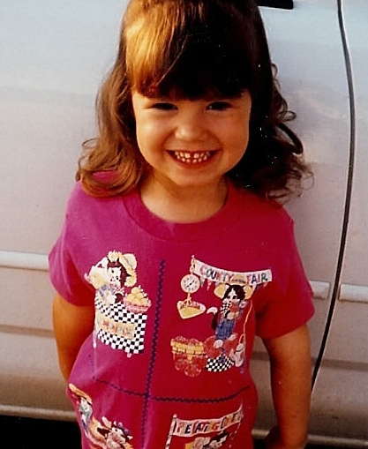
Demi Lovato basic information
Demetria Devonne Lovato was born on August 20. 1992 in Albuquerque, New Mexico to former Dallas Cowboys cheerleader Dianna De La Garza and engineer and musician Patric Martin Lovato. She has an older sister named Dallas and younger maternal half-sister, actress Medison De La Garza. Lovato was raised in Dallas, Texas.

Slide 3
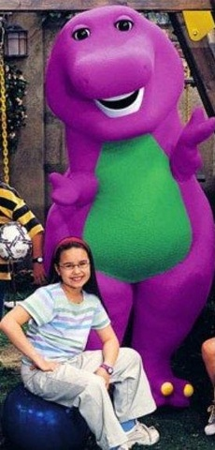
Beginning of a career
In 2002, she began her acting career on the children’s television series Barney & Friends as Angela. She began playing piano at age seven and guitar at ten, when she also began dancing and acting classes.She later became a spokesperson for the anti-bullying organization pacer and appeared on America's Next Top Model to speak out against bullying.

Slide 7
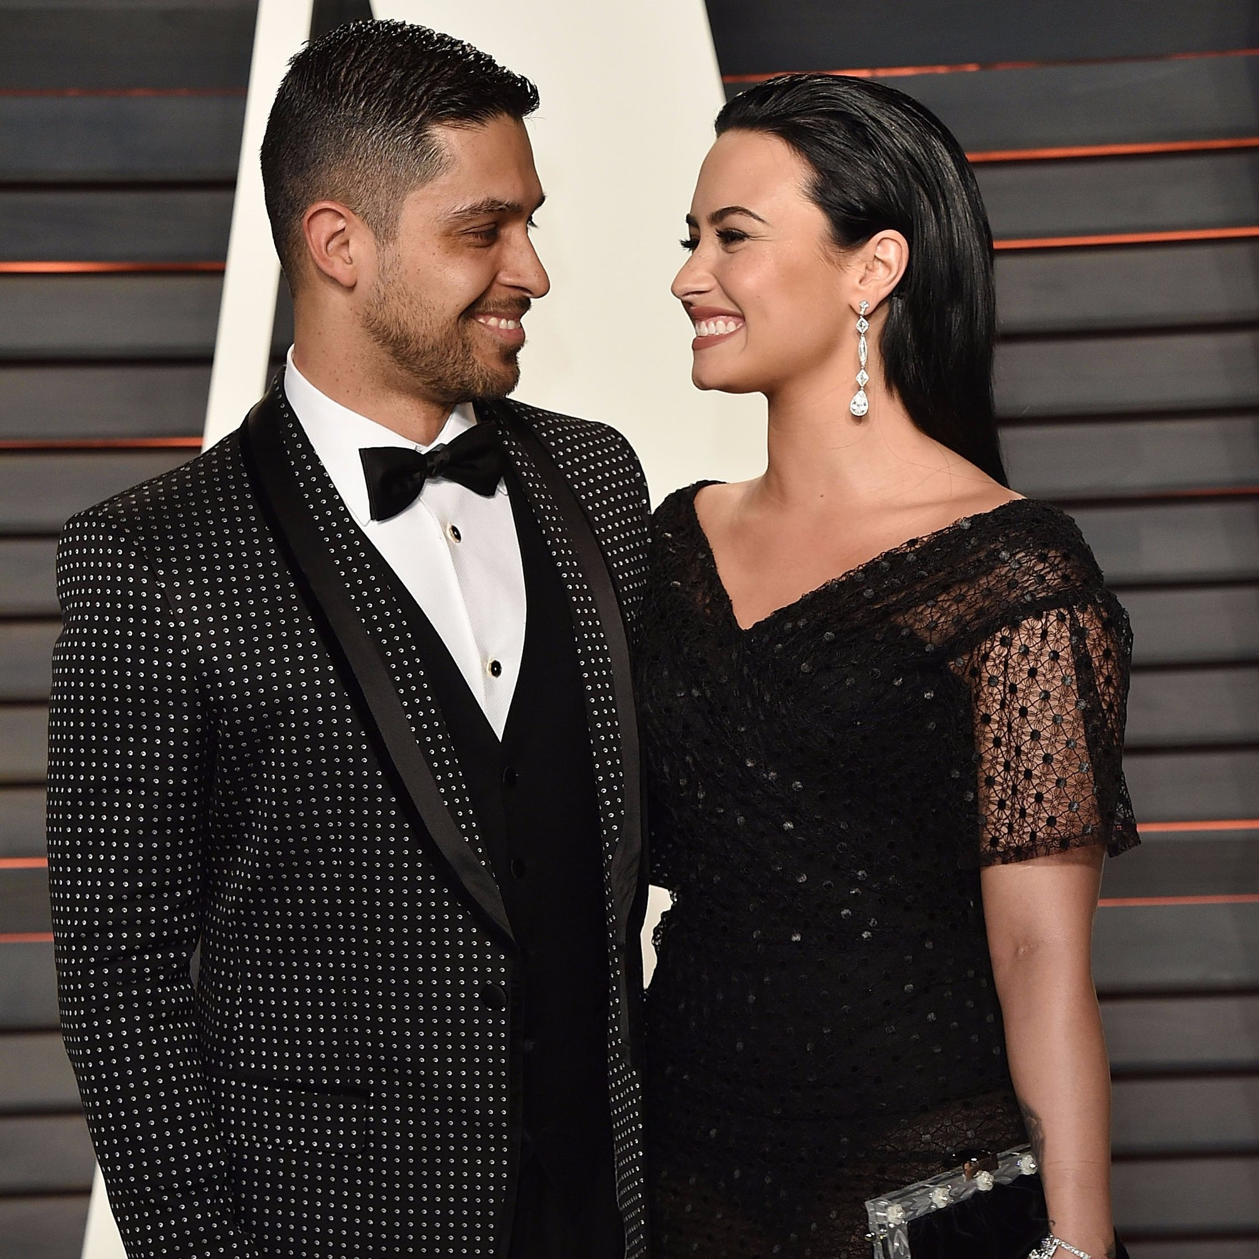
Love life Demi Lovato
Demi Lovato has been in the spotlight for a long time, so it’s no wonder she’s been linked to a few difference men. Some have only been brief flings you probably don’t even remember, while others have been around for years and left a mark when things ended. From a relationship she had when she first started out her career in 2007 to her long - term BFs, here’s a look at Demi’s love life

Slide 8
Demi Lovato’s mother Dianka also revealed that she has hope for the former couple, who split back in June 2016 after six years of dating, saying, “They‘re amazing friends and hopefully one day it will be more than that. And if it’s not not i, that will be up to her, I guess. But I do like them together.”

Slide 9
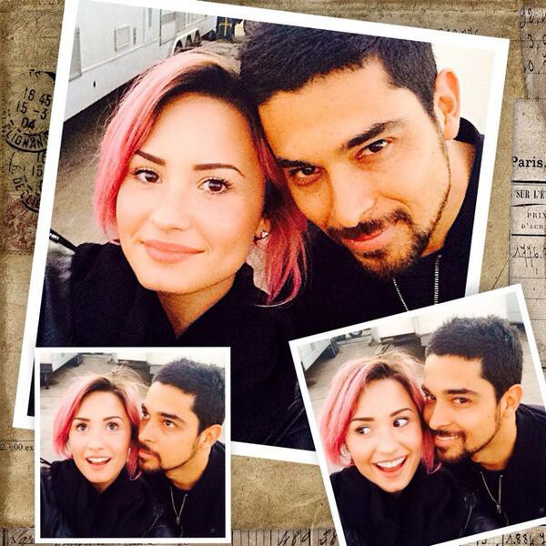
Demi admitted she was still in love with Willmer in her 2017 YouTube documentary, Simply Complicated. ‘I think my heart is always with Willmer “, the’ Sorry Not Sorry” singer confessed. “You don’t share six years with somebody and vice versa. I’m pretty sure I am not going to meet anybody that compares to him, but I’m trying to keep an open heart and an open wind when it comes to that “.

Slide 13
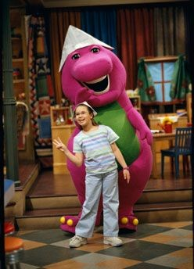
Demi Lovato’s accomplishments in life
Posted on December 17, 2012
In 2009, Lovato was named an Honorary Ambassador of Education by American Partnership for Eosinophilic Disorders. She was in Disney Channel Original Movie Camp Rock along with Jonas Brothers. This movie was a huge hit that they had a second one made. This was big for Demi because it was her first big gig besides Barney.

Slide 14
During her career Lovato has won over 50 awards, including:
An award at MTV Video Music Awards;
One award at the ALMA Awards;
5 awards out of 12 nominations at the People’s Choice Awards;
An award at the Latin Americans Music Awards.
In 2014 Lovato wa nominated for 6 World Music Awards and on 2016 she was nominated for Billboard Music Award and for Brit Award with Olly Murs.

Slide 15
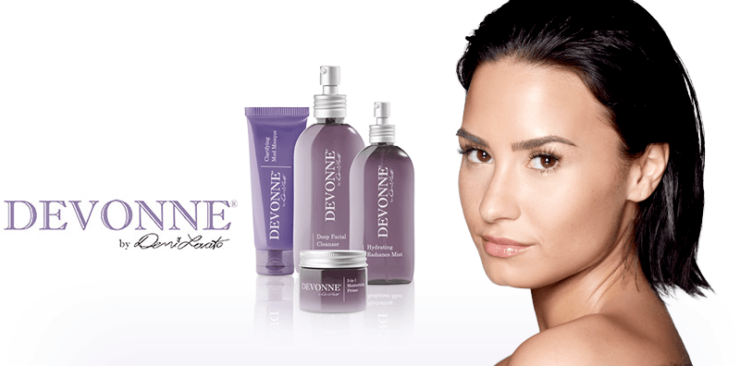
Lovato was nominated for Best Pop Vocal Album at the 59th Grammy Awards for her Album Confident.
Last year she released “DEMI LOVATO: Simply Complicated” a YouTube documentary that tells the story of her recovery.
In 2014 Demi ventured into the skincare business and announced her upcoming range of skincare products called “Devonne by Demi”

