Slide 4
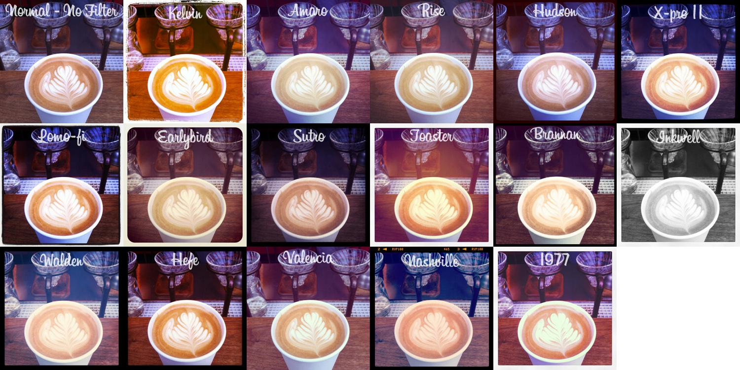
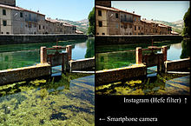
A photo collage An original photograph (left) is automatically
of an unprocessed image (top left) cropped to a square by Instagram, and has
modified with the 16 different a filter added at the selection of the user
Instagram filters

Slide 5
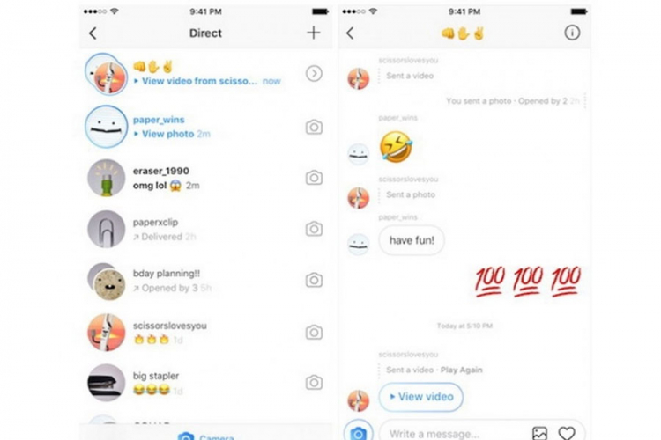
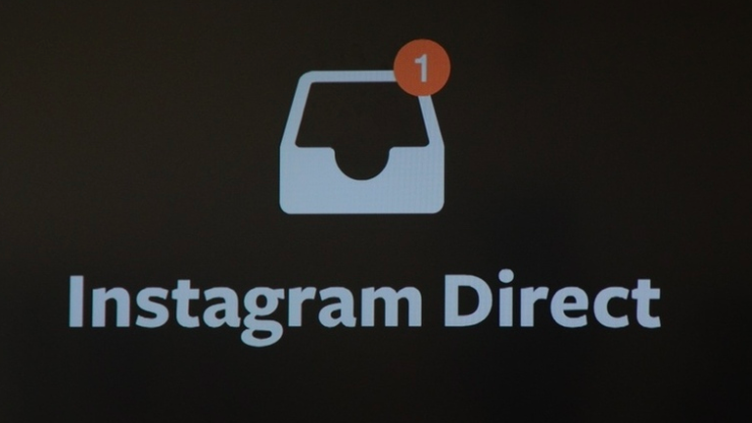
INSTAGRAM DIRECT
In December 2013, Instagram announced Instagram Direct, a feature that lets users interact through private messaging. Users who follow each other can send private messages with photos and videos, in contrast to the public-only requirement that was previously in place. When users receive a private message from someone they don't follow, the message is marked as pending and the user must accept to see it. Users can send a photo to a maximum of 15 people

Slide 6
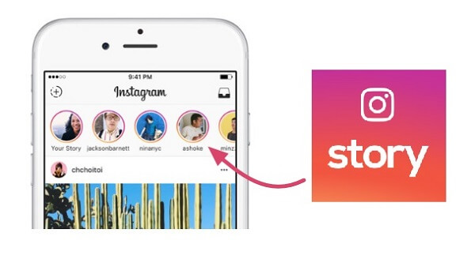
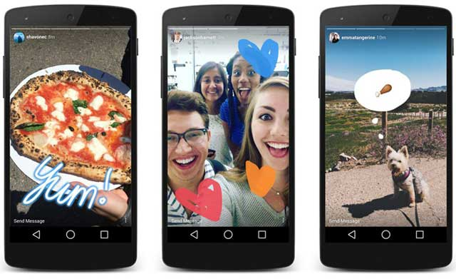
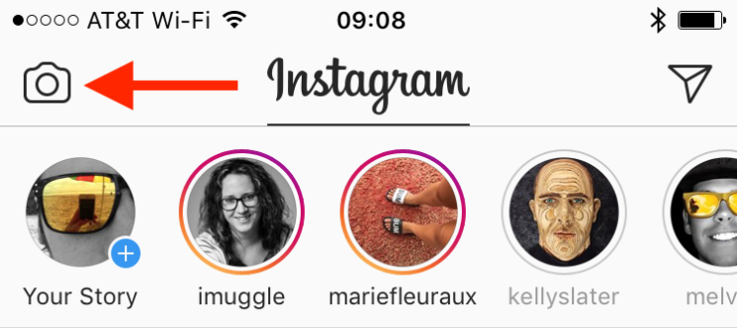
INSTA STORIES
In August 2016, Instagram launched Instagram Stories, a feature that allows users to take photos, add effects and layers, and add them to their Instagram story. Images uploaded to a user's story expire after 24 hours. The media noted the feature's similarities to Snapchat. In November, Instagram added live video functionality to Instagram Stories, allowing users to broadcast themselves live, with the video disappearing immediately after ending

