Slide 1
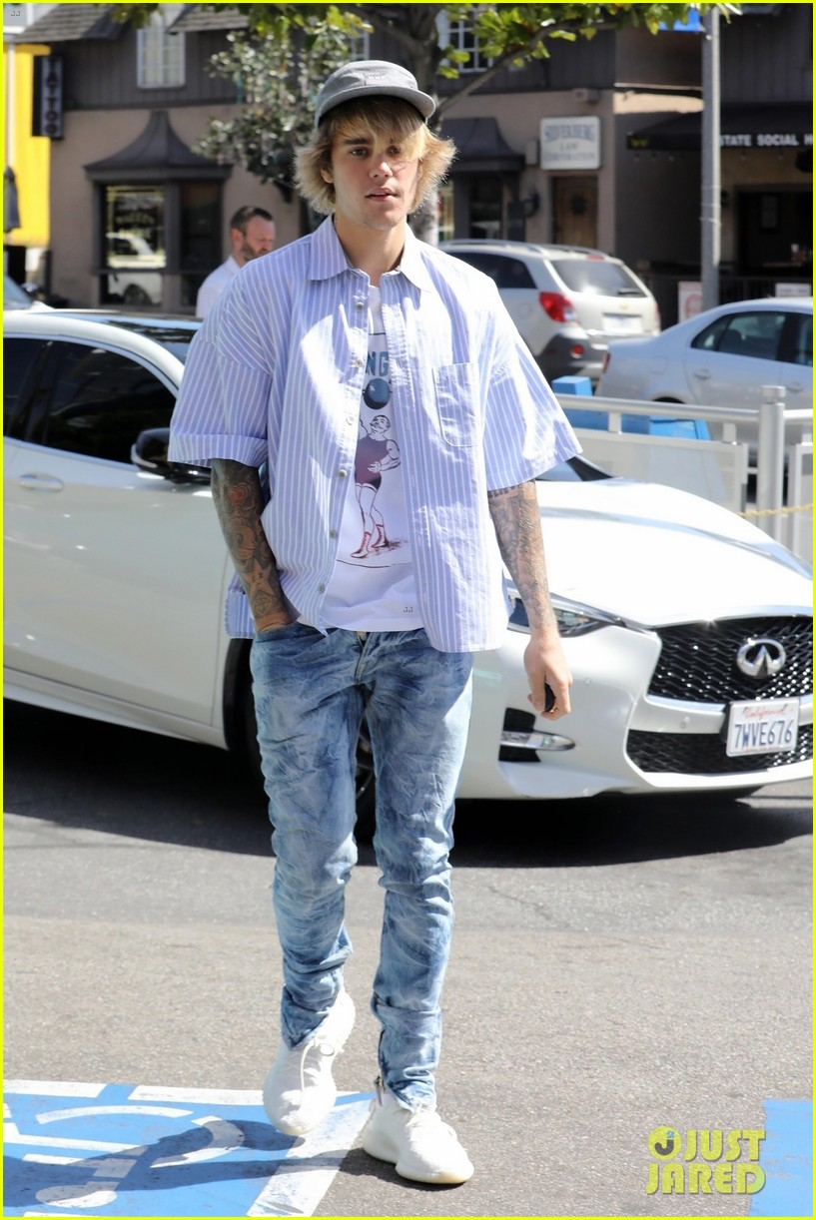
Justin Drew Bieber
AUTHORS:Natalija Grbic,Mia Durbaba,Marija Praizovic,Marija Misic,Andjela Filic,Jovana Georgiev
TEACHER:Milena Tasic

Slide 2
Justin Bieber biography
Justin Drew Bieber was born on March 1,1994,in Canada Ontario. He is a singer,actor and songwriter. He released his debut EP ‘My world’ in 2009. Following his debut album he has his first tour ‘My world tour’, then he released the remix albums ‘My worlds acoustic’ and ‘Never say never’. Later on, in 2011, he released his second album ‘Under the mistletoe’ which was number one on Billboard 200. His third album ‘Believe’ was released in 2012. His single ‘Boyfriend’ reached number one in Canada.

Slide 3
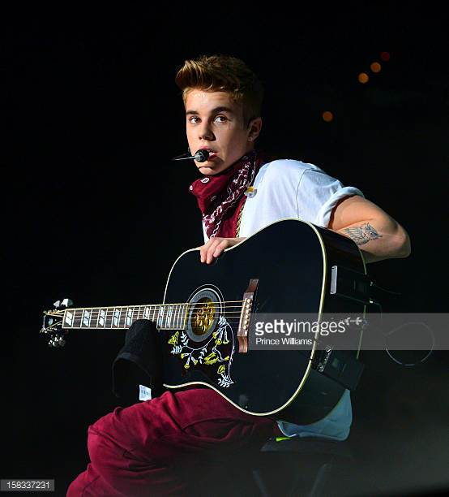
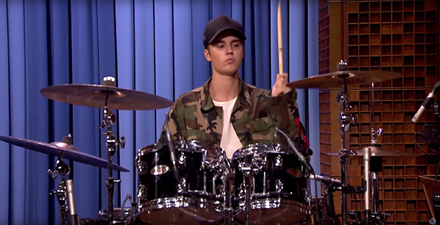
Hi has a lot of hit songs such as three number one singles ‘What do you mean’ , ‘Sorry’ and ‘Love yourself’ which were in his fourth album ‘Purpose’ released in 2015. He has sold over 140 million records, which makes him one of the world’s best-selling music artist. He became the second person to reach 100 million followers on Twitter in 2017. Besides or songwriting he can play instruments such as drums and guitar.

Slide 4
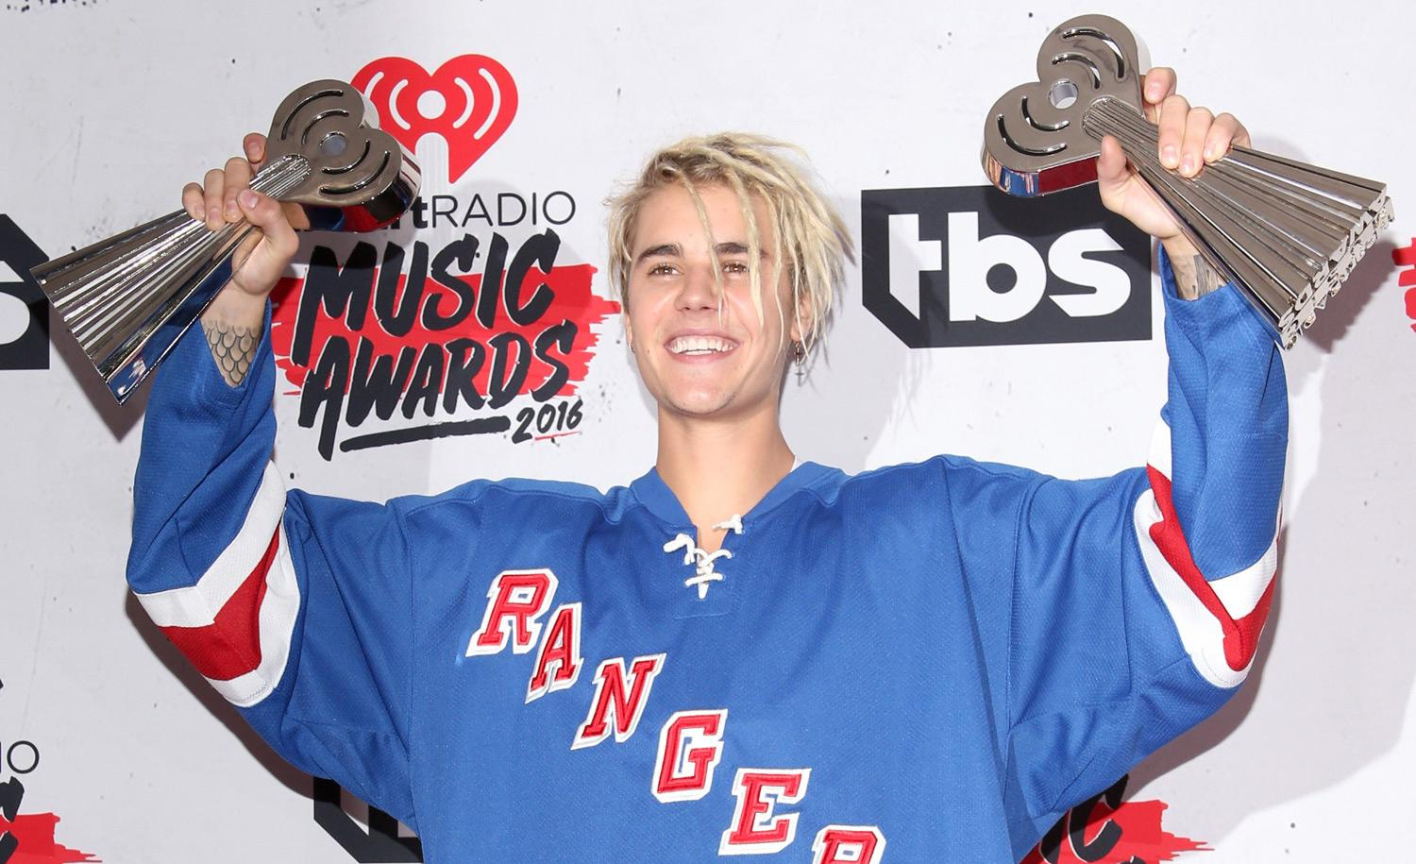
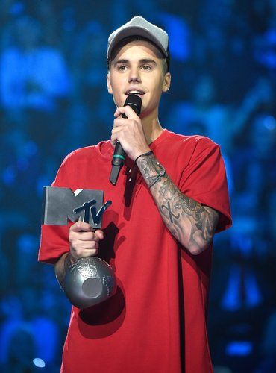
Awards
Throughout his career he won many awards such as: American music award for artist of the year in 2010 and 2012. In 2016 he won a Grammy award for best dance recording for the song ‘Where are Ü now’. Then in 2017 he won a Latin Grammy award for best urban performance for the remix of Despacito. He was listed four times by Forbes magazine among the top ten most powerful celebrities in world in 2011,2012 and 2013.

Slide 5
Beginning of a career
In early 2007, aged 12, Bieber sang Ne-Yo's "So Sick" for a local singing competition in Stratford and was placed second. When searching for videos of a different singer, Scooter Braun, a former marketing executive of So So Def Recordings, clicked on one of Bieber's 2007 videos by accident. Impressed, Braun tracked down the theatre that Bieber was performing in, located Bieber's school.At 13,Bieber moved to Atlanta with his mother to pursue further work with Braun and Usher.Braun became Bieber's manager in 2008.

Slide 6
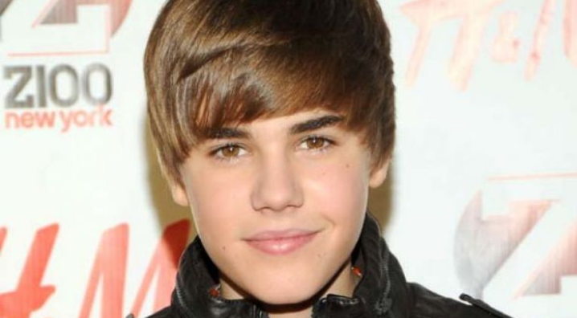
First single
Bieber's first single, "One Time", was released to radio while Bieber was still recording his debut album. The song reached number 12 on the Canadian Hot 100 during its first week of release in July 2009.

Slide 7
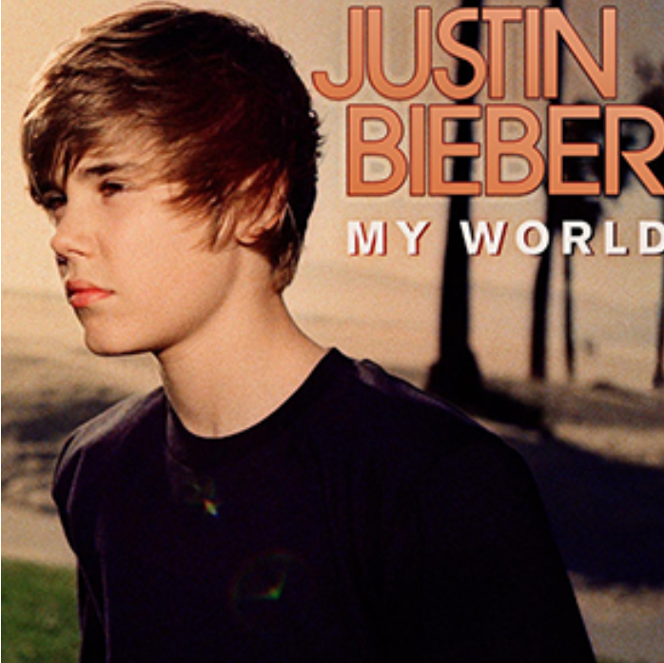
First album
His first album,My World, was released on November 17, 2009. The album's second single, "One Less Lonely Girl", and two promo singles, "Love Me" and "Favorite Girl" were in the top 40 of the Billboard Hot 100.

Slide 8
Albums
Justin Drew Bieber is a Canadian singer. After a talent manager discovered him through his YouTube videos covering songs in 2008 and he signed to RBMG, Bieber released his debut EP, My World.
My World (2009)
My World 2.0 (2010)
My Worlds (2010)
My Worlds: The Collection (2010)
My Worlds Acoustic (2010)
Never Say Never: The Remixes (2011)
Under The Mistletoe (2011)
Believe (2012)
Believe Acoustic (2013)
Journals (2013)
Purpose (2015)

Slide 9
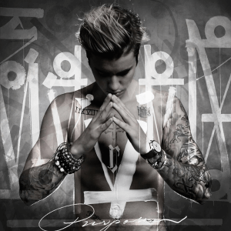
Purpose
*On August 28, 2015, Bieber released a new single titled "What Do You Mean?" as the lead single from his fourth studio album Purpose.
*On October 23, 2015, Bieber released the album's second single titled "Sorry"
*The third single from Purpose, "Love Yourself" also peaked at number one in the US, making Bieber the first male artist
Purpose was released on November 13, 2015, and debuted at number one on the Billboard 200, becoming Bieber's sixth album to debut at the top of that chart.It was the fourth best-selling album of 2015 with worldwide sales of 3.1 million copies. As of June 2016, it had sold 4.5 million copies globally.On November 11, 2015, Bieber announced he will embark on the Purpose Tour.

Slide 10
Best selling albums

Slide 11
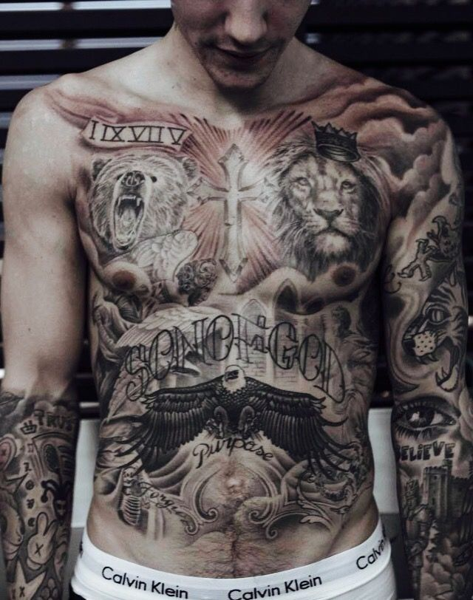
HIS TATTOOS
Tattoos are the big part of his life.
Every single tattoo on his body has a very big meaning to him, because most of them are related to God or his family.
His first tattoo is the one that says BELIEVE, also that tattoo has so many meanings but the top 3 are.
1.his faith in God
2.believe is also the name of his number one album
3.and the last but not the least reason is because of his life motto that goes “ALWAYS BELIEVE”

Slide 12
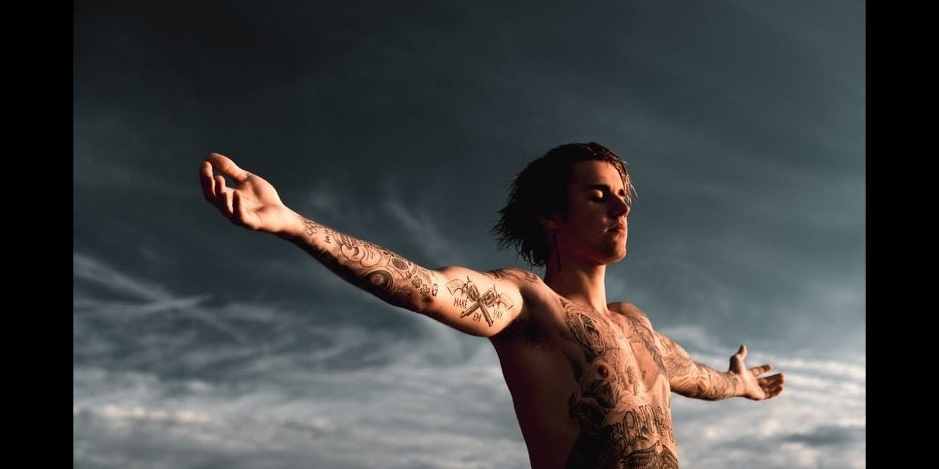
FUN FACTS
Justin never had the same hair for more than a month.He likes to experiment a lot.at first he had a “BEAB WAVE” as everyone said,that he cut it and colored it blue.Now he has a brown hair and he is trying to recover it.
The thing that is most important to him about his performances is dancing and equipment,so he has a big team that does that for him.Besides the big team his the one that does organization and in every rehearse his the coach.When he was preparing for his number one world tour he was at the dncing studio for 14 hours.
Also for the song “BEAUTY AND BEAST” he was the one that did every single thing.From the music video to editing and filming.So that was his first baby as he likes to call it.

Slide 13
Justin Bieber and his girlfriends
Ever since Justin Bieber rose to fame in 2008, the heartthrob singer has been romantically linked to many of Hollywood’s hottest stars. While Selena Gomez is probably his most famous romance, she certainly isn’t his only one!

Slide 14
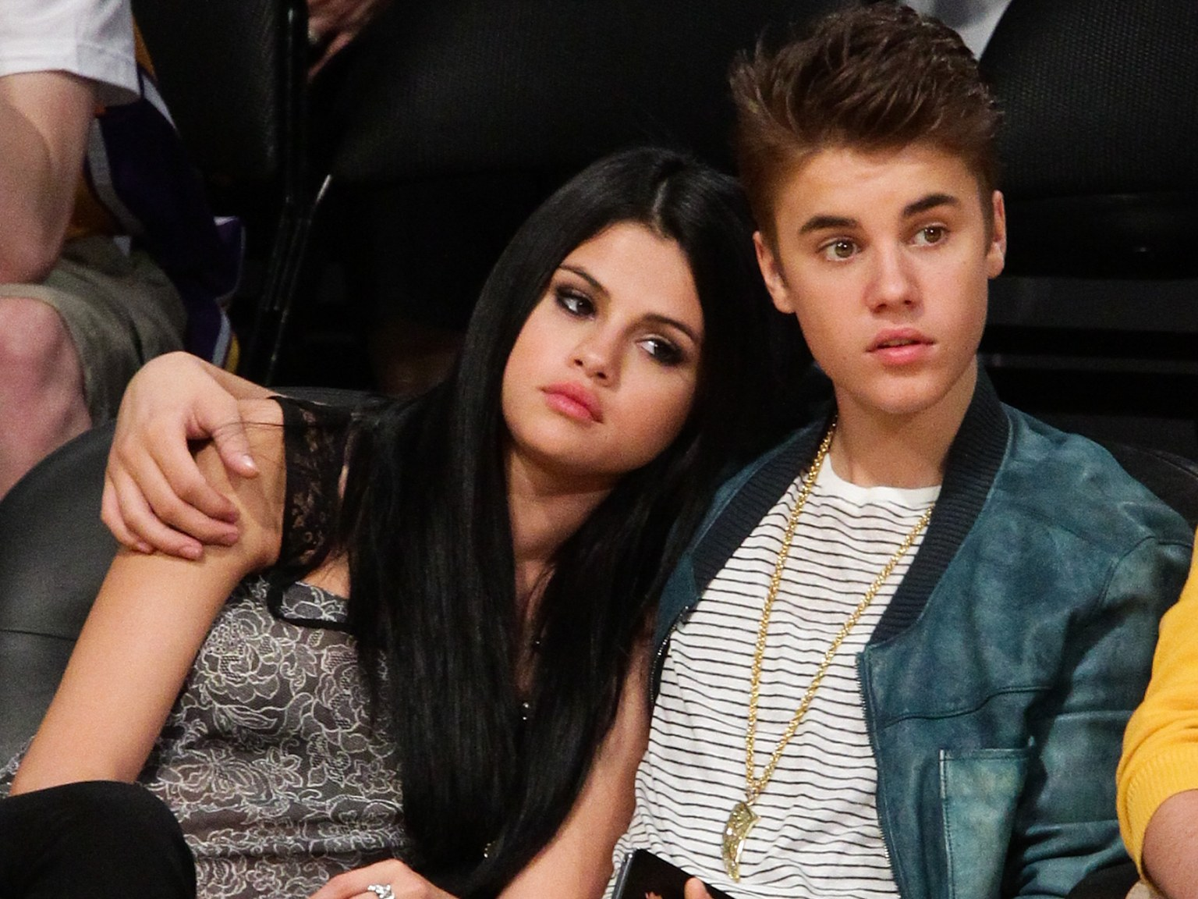
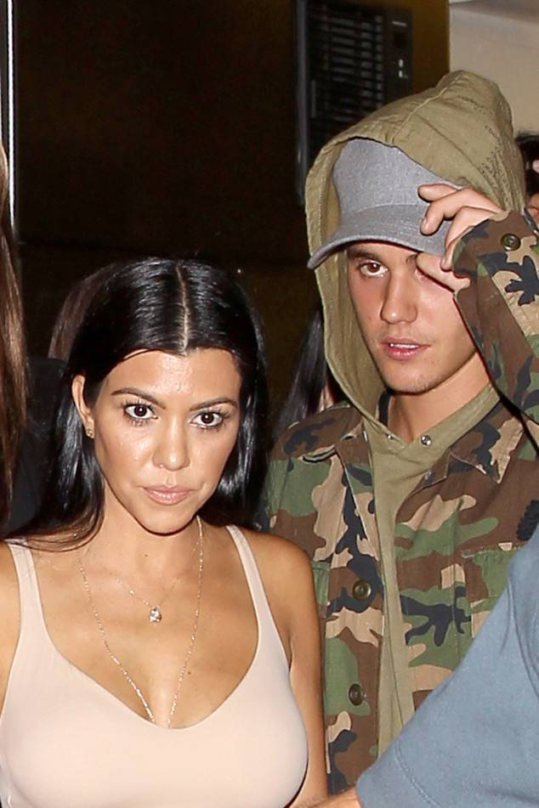
In December 2010, Bieber began dating Selena Gomez. After separating in November 2012, they reconciled a few weeks later before splitting up again in January 2013.They later reconciled for a few months in each of 2013, 2014, and 2015.
In 2014, Bieber began dating Kourtney Kardashian, their relation lasting on-and-off through 2016. In 2017 they dated briefly once again. There has been speculation that Reign Disick, Kourtney’s son, is actually Bieber’s biological child due to a close physical resemblance between the two.

Slide 15
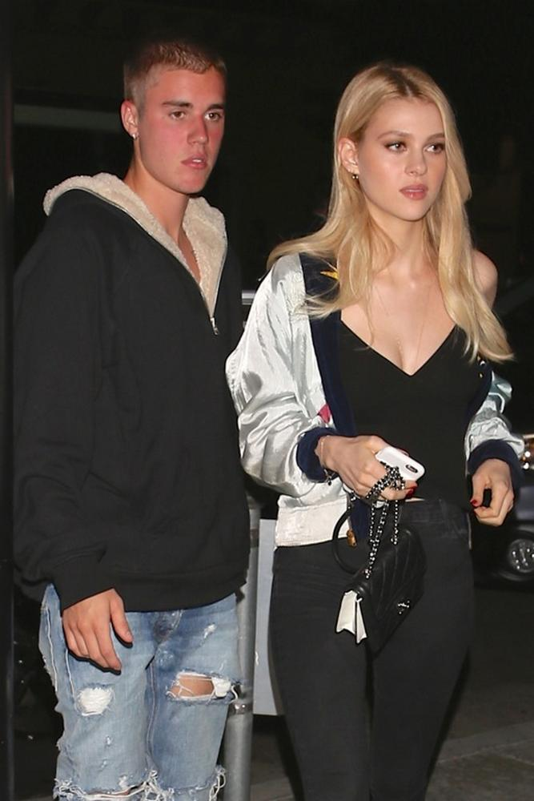
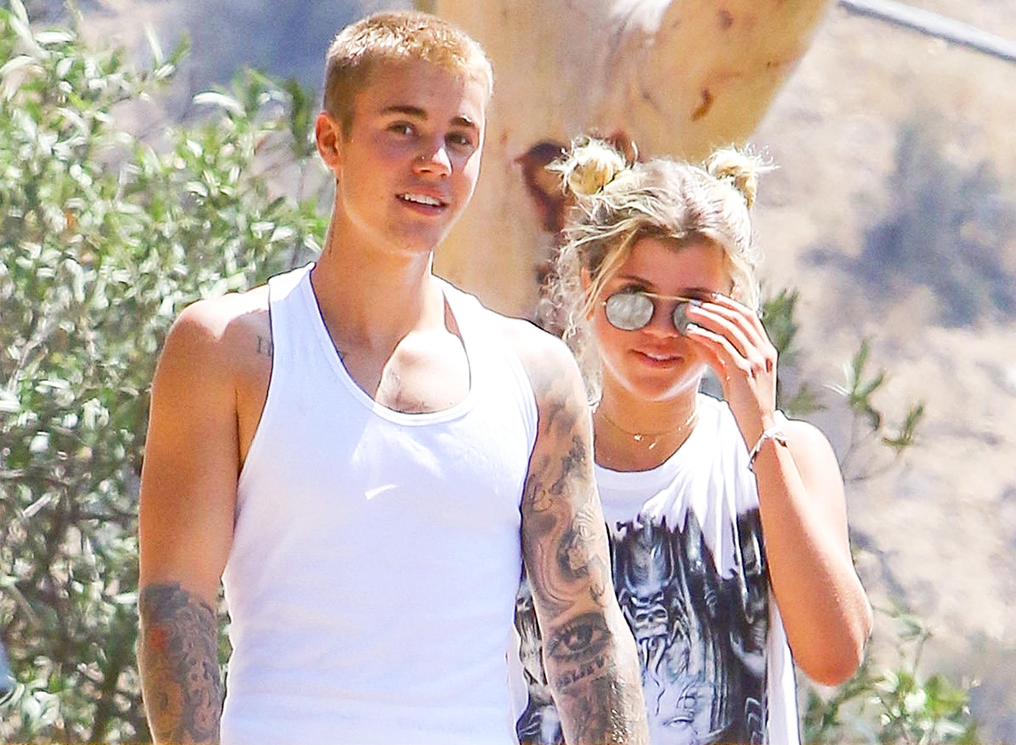
In 2016, he dated Nicola Peltz, daughter of billionaire Nelson Peltz. They broke up after a few weeks.
In 2017, Bieber dated Sofia Ritchie for several months, before reuniting with Gomez. After the breakup with Gomez, there have been several “run ins” with his ex, Kardashian.

Slide 16
CAREER
D
R
E
A
M
B
I
G
Justin Bieber started his career when he was just 12 years old. After taking the second place at the “Statford Idol” competition, his mother decided to post a video online of him performing. Views shocked her so she started posting videos of him on YouTube and manager called Scooter Braun who saw the videos by accident. He immediately offered him a contract.
HARDWORK

Slide 17
With his manager and working with Usher he posted his first single “One time”. Soon after he blew up on the Internet and people loved him.Then in 2010. He posted his first platinum hit called “Baby” and four other songs which are also very viewed.That same year he won award of “The Music Of the Year” and Grammy for “The Best Pop Vocal Album” and “The Best New Artist”. He filmed his documentary were he talked about his success in details.

Slide 18
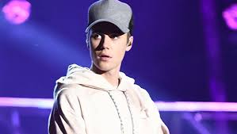
Today he’s a very successful singer and songwriter who has a lot of fans across the world.
He has sold over a 140 milion records,making him one of the world best -selling music artist.

