Slide 4
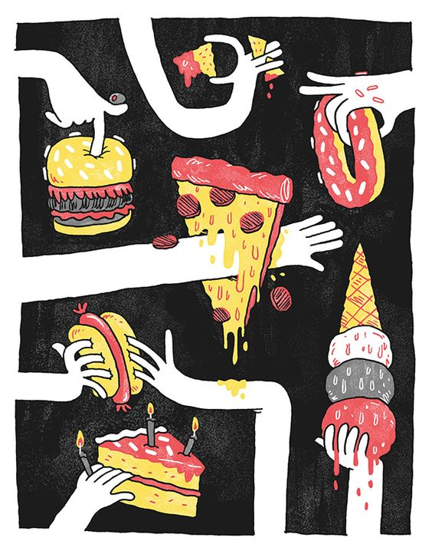
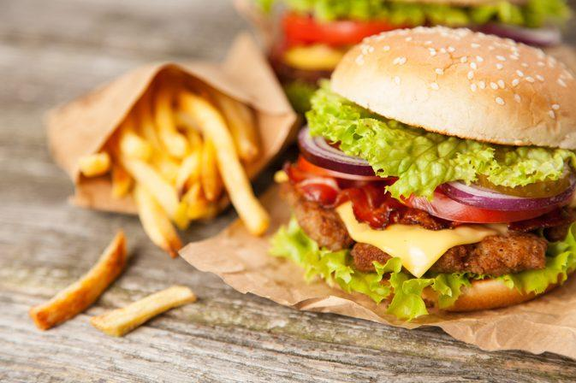
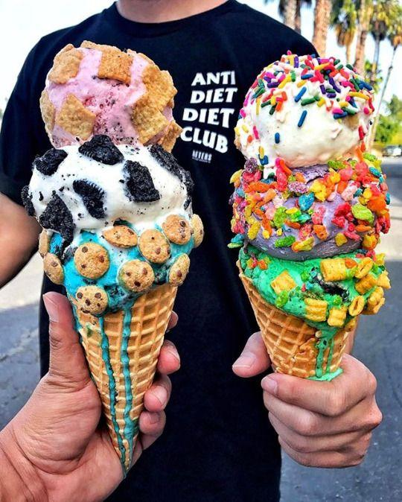
Unhealthy food
Junk food is a term for food containing high levels of calories from sugar or fat with little fiber, protein, vitamins or minerals. Junk food can also refer to high protein food like meat prepared with saturated fat.
Eating junk food alters the brain activity in a way similar to addictive drugs do, such as cocaine and heroin.

Slide 5
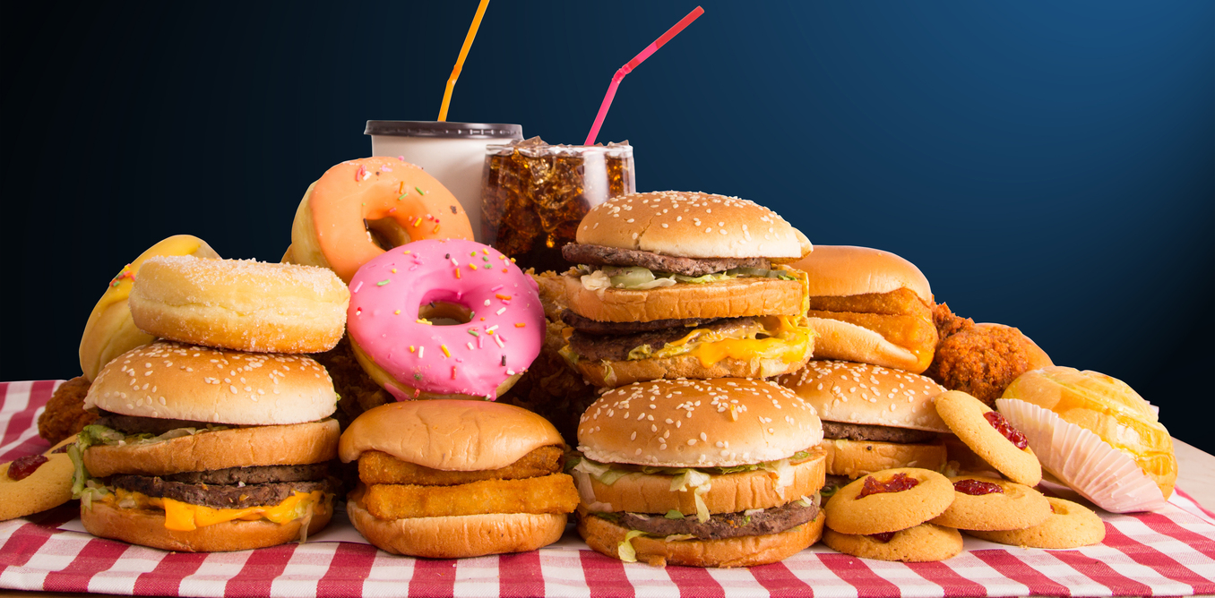
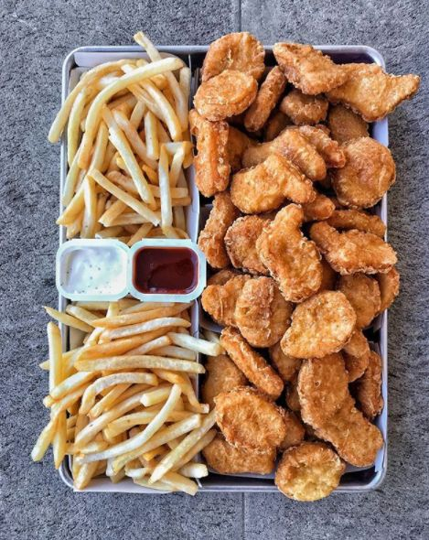
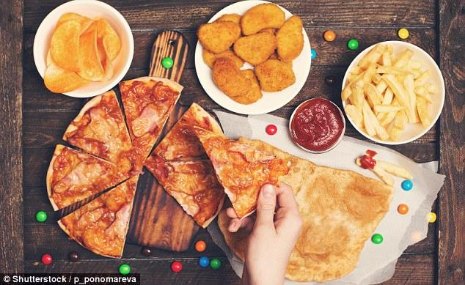
Mental health
Eating too much junk food may aggravate symptoms of mental illnesses such as depression and anxiety. Unhealthy food choices and diet habits may also increase your chances of developing mental diseases like Alzheimer's later in life.
A single fast-food hamburger can contain meat from hundreds, or even thousands, of different cattle.

Slide 6
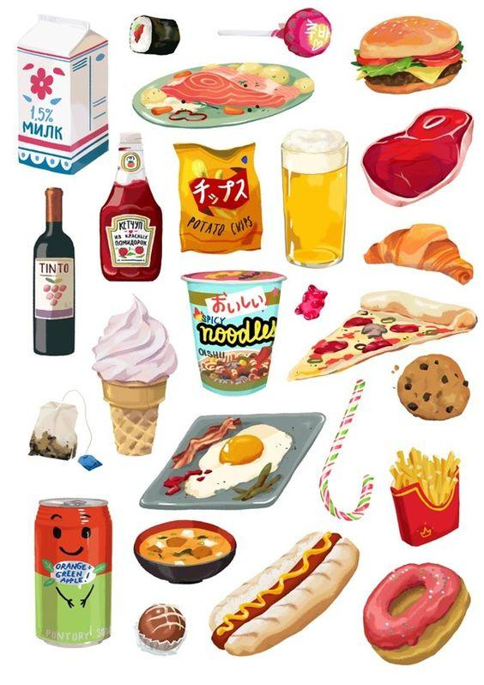
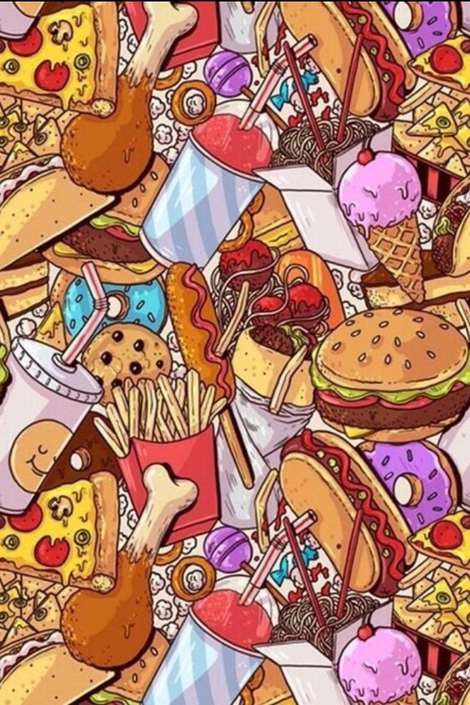
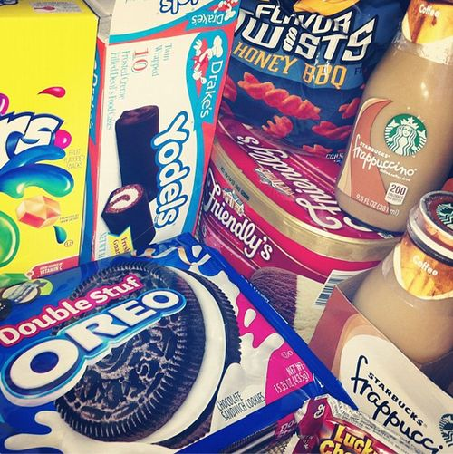
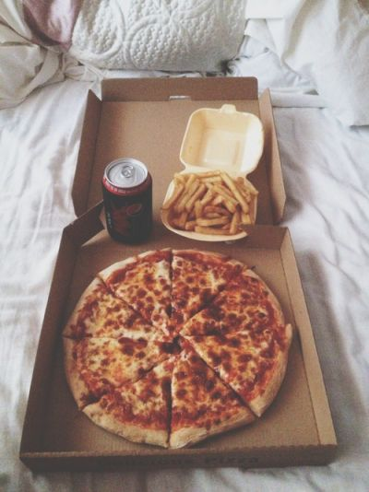
Fats from junk food trigger the brain to want more food. This effect can last for several days.
While eating ice cream may seem a delicious way to cool off, the high fat content in the tasty treat actually warms up the body.
Young women who eat a junk food diet are at a higher risk for developing Polycystic Ovarian Syndrome.
If a hot dog package says that it includes the phrase "with variety meats" or "with meat by-products," the hot dog probably includes such meats as liver and and heart.

Slide 10
Mental health
Mental health is a level of pathological well-being, or an absence of mental illness. It has an impact on all people despite their religious views, ethnicity, educational level or economic position.
Did you know?
A study showed that the average high school kid today has the same level of anxiety as the average psychiatric patient in the early 1950’s.

Slide 11
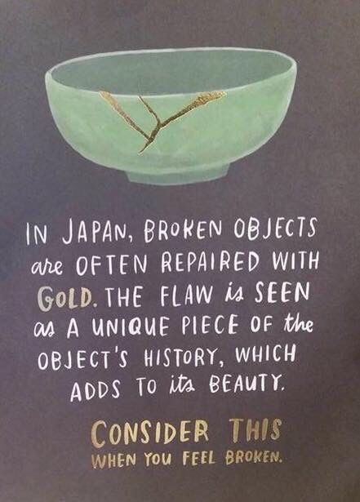
In the mid-19th century the term "mental hygiene" was first used as an attempt to promote mental health awareness, and has been in use ever since.
Stress is often referred to as “the silent killer” because it has been linked to heart disease, high blood pressure, chest pain and early death.

Slide 12
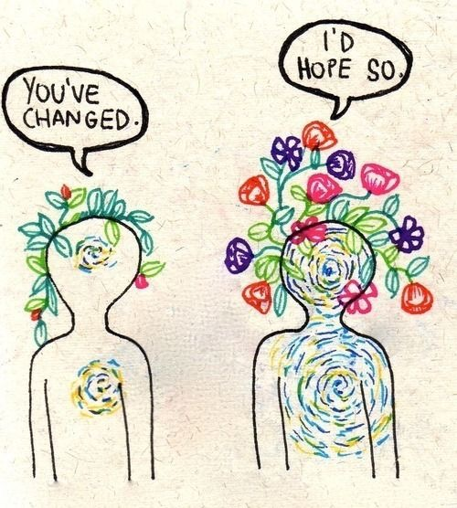
Mental health has to be worked on daily and can be achieved during a period of time. Changing our daily habits can slowly but surely help us not feel the pressure of everyday life.
"In any given moment we have two options: to step forward into growth or to step back into safety." -Abraham Maslow

