Slide 1
BASKETBALL
English
Milena Tasić
Anja Rokvić
Marija Vučićević ​
Iva Stojković II2
Ksenija Perišić​
Tamara Milisavljević

Slide 2
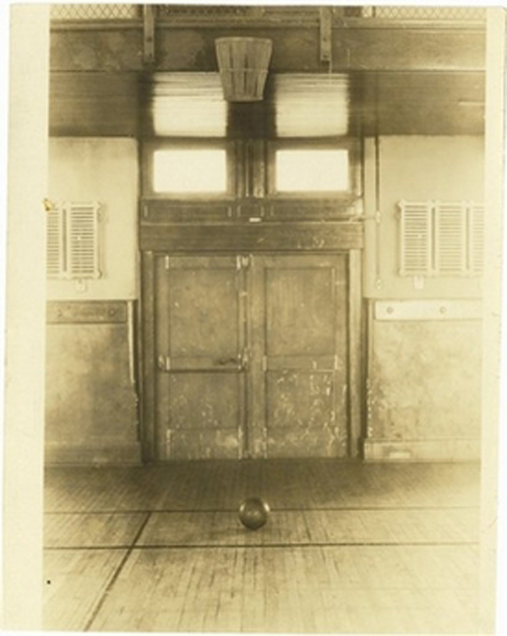
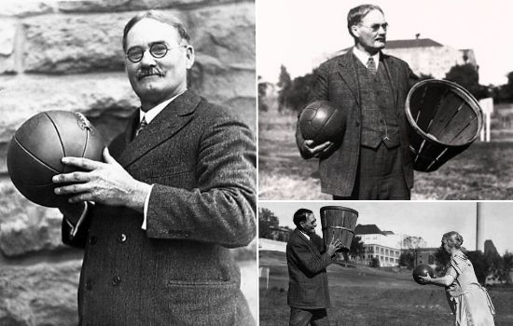
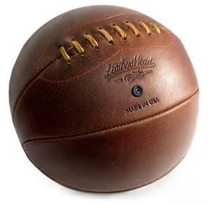
HISTORY
Basketball is a kind of a team sport. You played it with a ball, with your hands. Two teams composed of five players are trying to score points by throwing the ball in the hoop. Winer is the team that scores more points .​
At the beginning of December 1891. James Naismith, Canadian doctor on University of Mcgill and professor of PE on College Springfield, he designed a new game in closed terrain witch would serve as maintenance condition of students during long winters.​
Hoop was different from todays by having a solid bottom, while today they have net. Naismiths game was similarly to handball which was created approximately at the same time as basketball, at the end of 19 century.

Slide 3
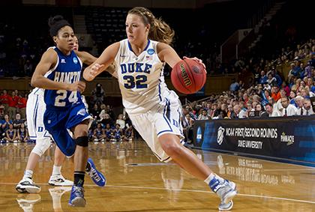
Women basketball started in 1894. when Senda Berenson, professor of PE , adapted Naismith rules to women. First official basketball game was 20th of January 1892. in hall in High school of youth association.​
​Original name of basketball in English is Basketball. Game was popular at very beginning.

Slide 4
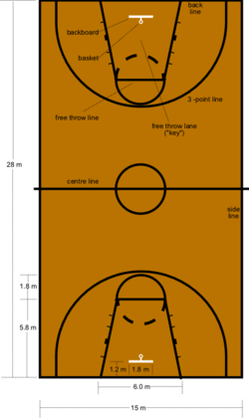
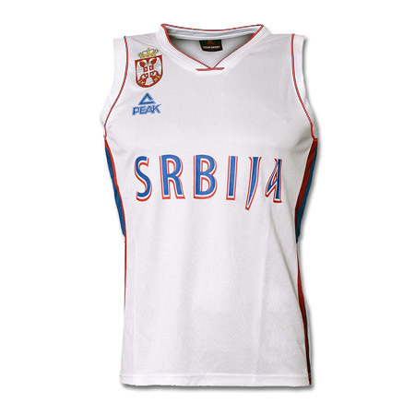
RULES
Competition rules are strict and they are international and NBA rules.​
Basketball rules that include the dimensions of the court, hoops, balls, uniforms and duration of the game... protected and provided by delegated judges.

Slide 5
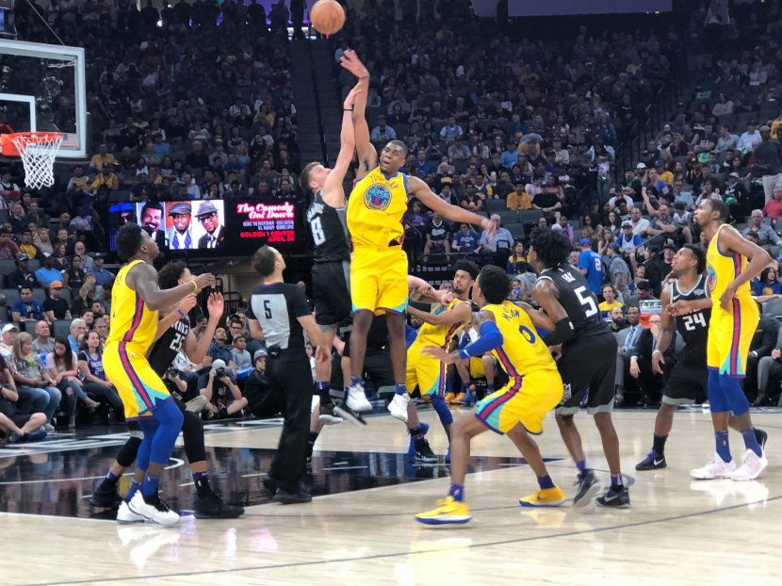
There may be five players at the same time on the court in the game. Teams may have maximum of seven substitutions.​
Replacements can be performed indefinitely, but only when the clock is stopped.​
Teams have a coach who most often develop tactics and strategy, and other staff who also actively participate but out of the court.

Slide 6
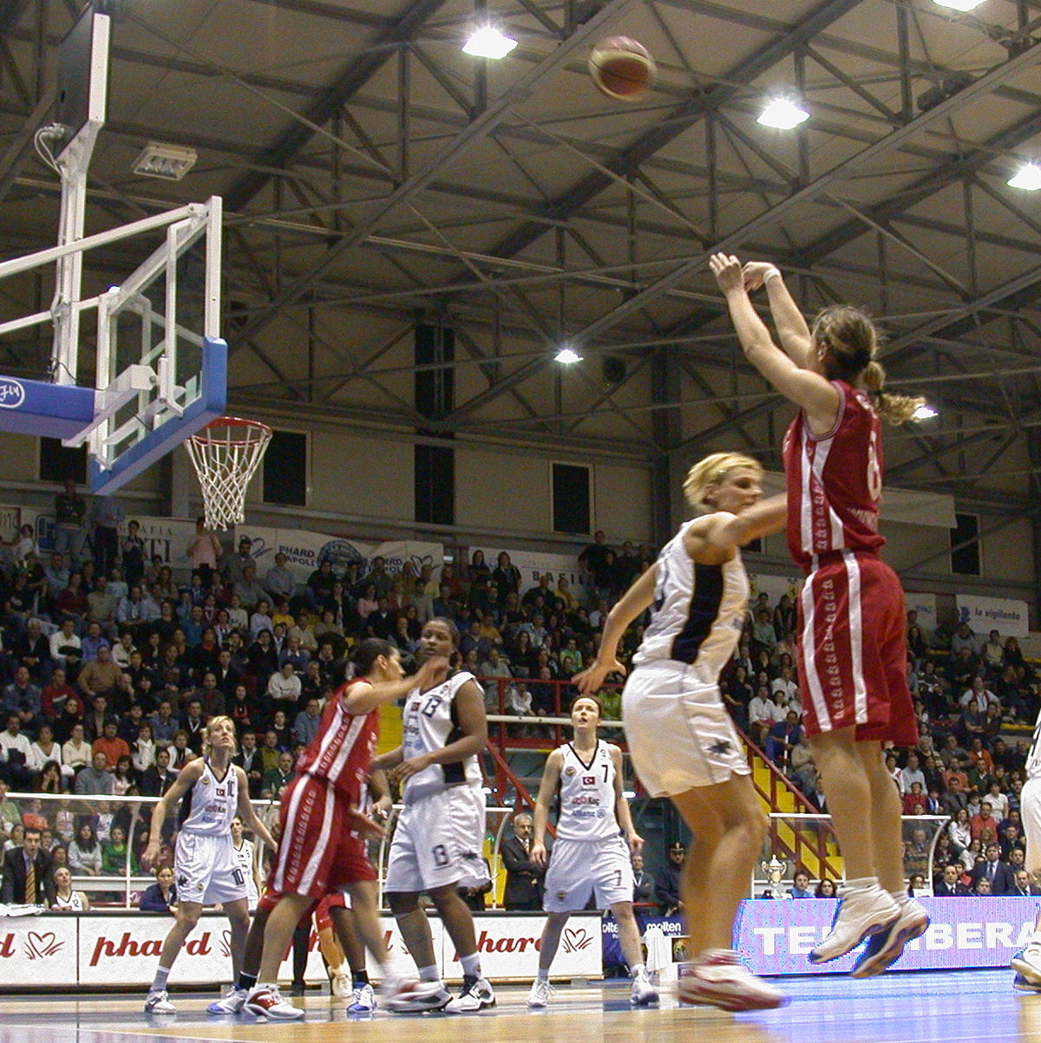
The game is played in four quarters of ten or twelve minutes. At the faculties there are two halves of twenty minutes, while most college plays four quarters of ten minutes.

Slide 7
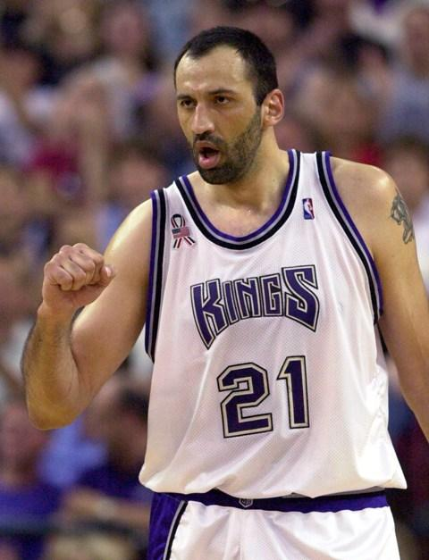
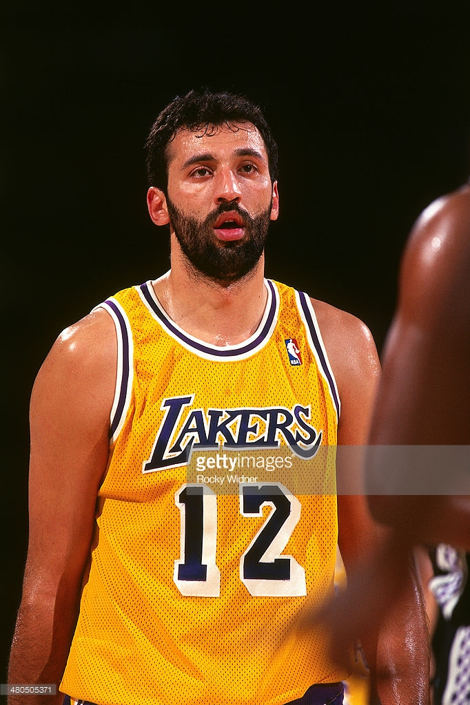
HOME PLAYERS
Vlade Divac was born in Prijepolje 3rd of February 1968. He is former Yugoslav and Serbian player. He played at the center position in Sloga,​
Partizan, Crvena Zvezda, Los Angeles Lakers, Sacramento Kings and Charlotte Hornets. He was one of the first European players to play in the NBA. With the national team of Yugoslavia he won two world championships, three European championships and two silver medals at the Olympic Games.​
He was in the position of President of Partizan while he was playing ,in the period from 2000. to 2004. After finishing his career he become a scout of Los Angeles Lakers and sports director of the Real Madrid.

Slide 8
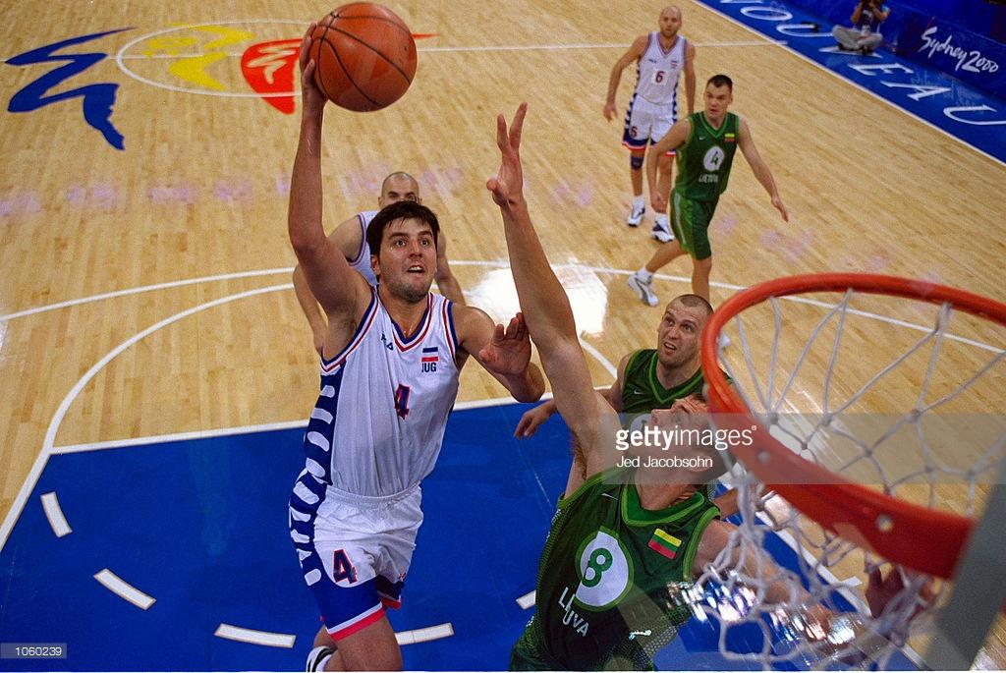
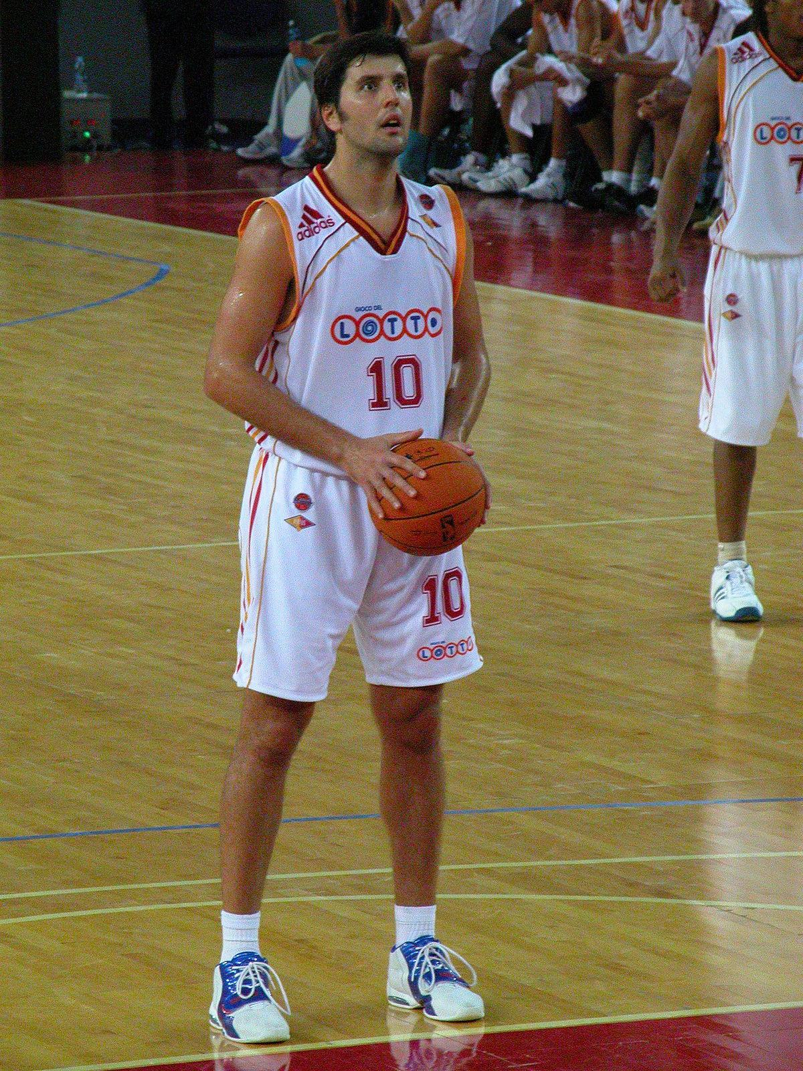
Dejan Bodiroga was born in Zrenjanin on 2nd of March 1973. Many basketball fans regard him as the best player ever, who didn’t play in the NBA league. With the national team of Yugoslavia he won silver at the Olympic Games 1996., two world championships and three European championships. He is known for the leadership, basketball intelligence and ability to play in all positions.

Slide 9
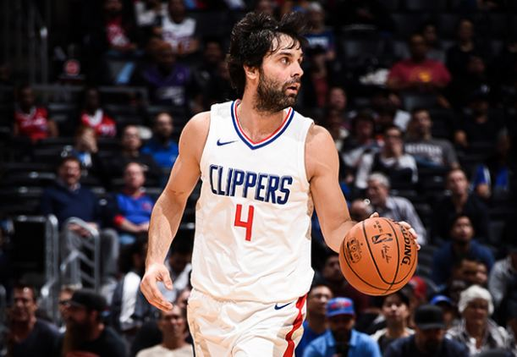
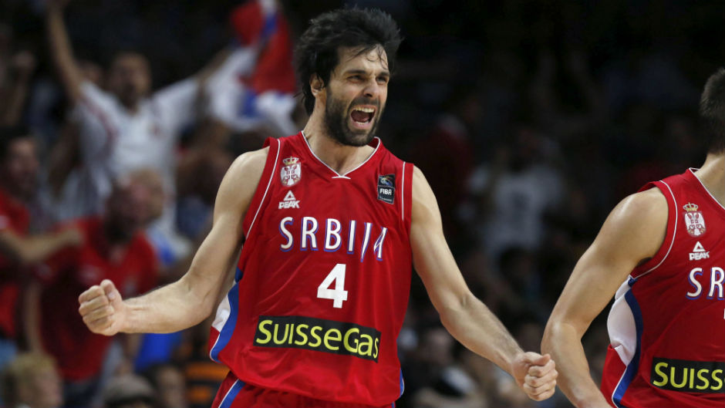
Milos Teodosic started his career in clubs in Valjevo, Student, and KK Metalac, and continued in Borca and FMP Zeleznik. With FMP Zeleznik he won Cup Radivoje Koraca 2007. His first coach was Milovan Teofilovic.​
At the European Basketball Championship for players up to twenty years old in Slovenia and Italy he won the gold medal and was declared the most useful player of the championship. The Serbian selector Zoran Slavnic, put him in the European Basketball Team which the team failed to qualify for the second round. At the World Cup in Turkey in the quarter-final match against Spain he scored from nine meters, three seconds to the end, where Serbia went to the semifinals. ​
At the end of the tournament he was selected in the top five players of the championship.

Slide 10
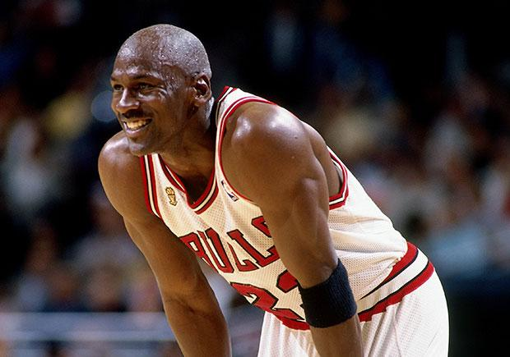
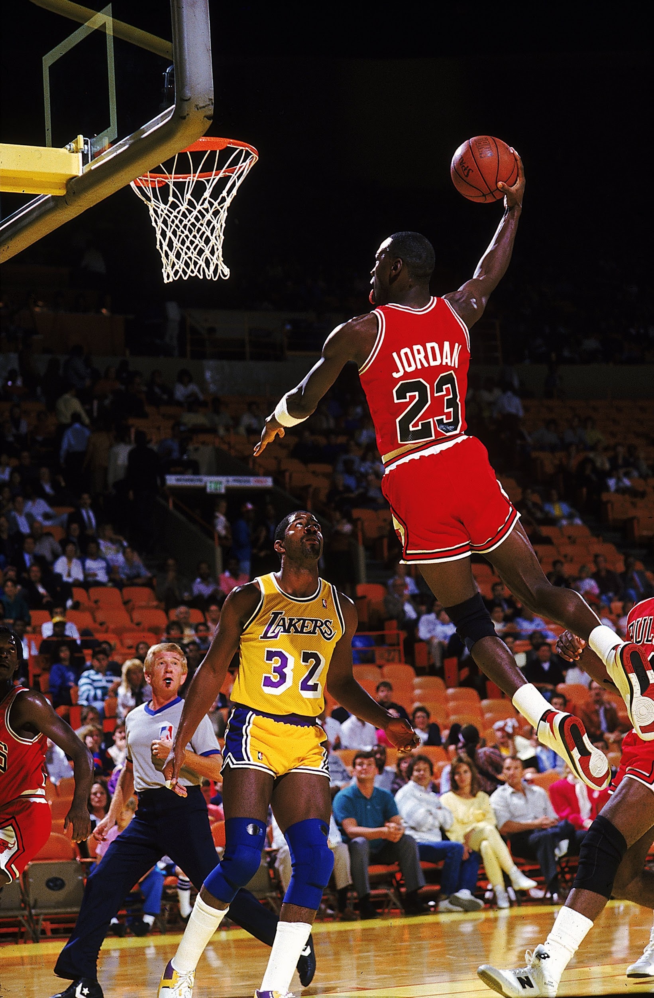
FOREIGN PLAYERS
Michael Jeffrey Jordan (born February 17, 1963), also known by his initials, MJ is an American retired professional basketball player. Jordan played 15 seasons in the National Basketball Association (NBA) for the Chicago Bulls and Washington Wizards. His biography on the NBA website states: "By acclamation, Michael Jordan is the greatest basketball player of all time.Jordan was one of the most effectively marketed athletes of his generation and was considered instrumental in popularizing the NBA around the world in the 1980s and 1990s.He is currently the principal owner and chairman of the Charlotte Hornets of the NBA.

Slide 11
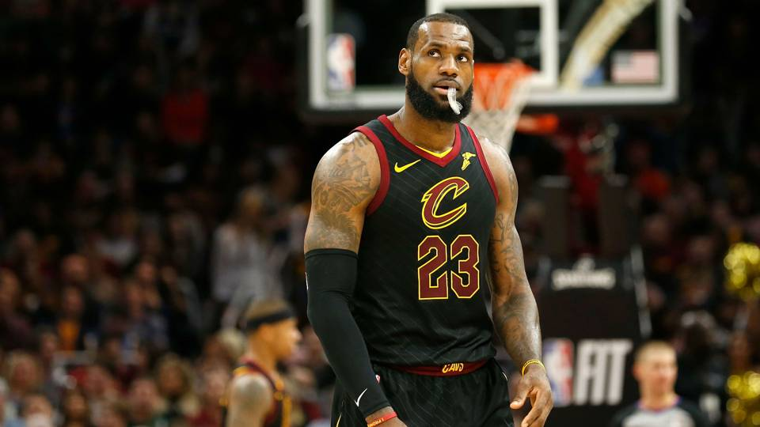
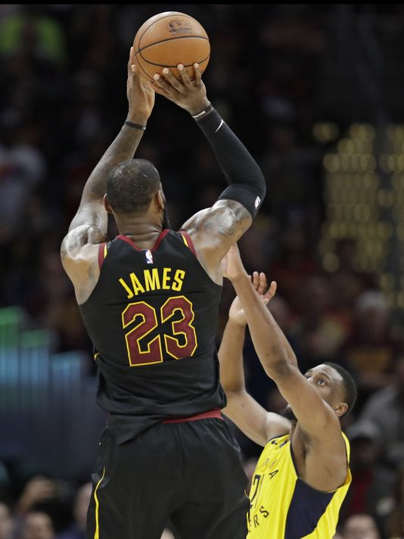
LeBron Raymone James Sr. ( born December 30, 1984) is an American professional basketball player for the Cleveland Cavaliers of the National Basketball Association (NBA). Widely regarded as one of the greatest NBA players of all time, he has won three NBA championships, four NBA Most Valuable Player Awards, three NBA Finals MVP Awards, three NBA All-Star Game MVP Awards, two Olympic gold medals, an NBA scoring title, and the NBA Rookie of the Year Award. James is a 14-time NBA All-Star, 11-time All-NBA first teamer, and five-time All-Defensive first teamer. He is also the Cavaliers' all-time scoring leader, the NBA All-Star Game career scoring leader, and the NBA career playoff scoring leader.

Slide 12
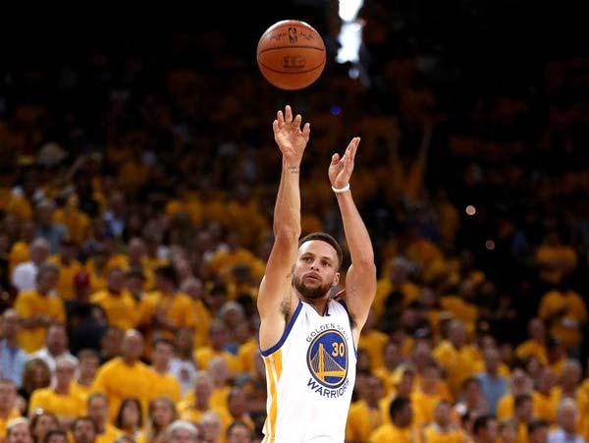
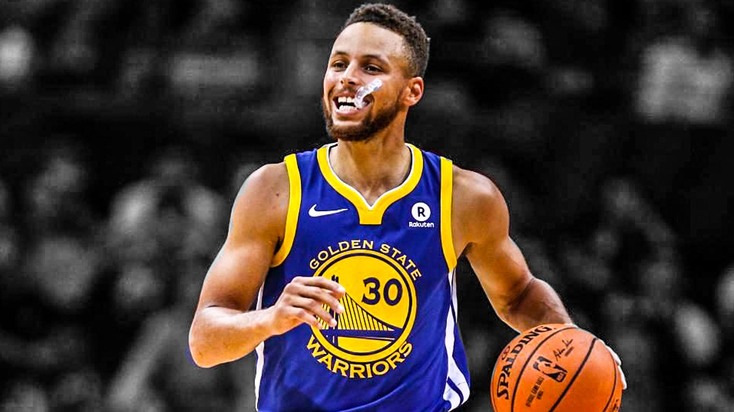
Wardell Stephen Curry II ( born March 14, 1988) is an American professional basketball player for the Golden State Warriors of the National Basketball Association (NBA). Many players and analysts have called him the greatest shooter in NBA history.In 2014–15, Curry won the NBA Most Valuable Player Award and led the Warriors to their first championship since 1975. The following season, he became the first player in NBA history to be elected MVP by a unanimous vote and to lead the league in scoring while shooting above 50–40–90. That same year, the Warriors broke the record for the most wins in an NBA season en route to reaching the 2016 NBA Finals, which they lost to the Cleveland Cavaliers. Curry helped the Warriors return to the NBA Finals for a third straight year in 2017, where he won his second NBA championship.​

Slide 13
HOME CLUBS
KK Crvena Zvezda​ KK Partizan
KK Mega Vizura​ KK FMP

Slide 14
FOREIGN CLUBS
Boston Celtics​ Cleveland Cavaliers Golden State Warriors
​
Chicago Bulls​ Houston Rockets Los Angeles Lakers

Slide 15
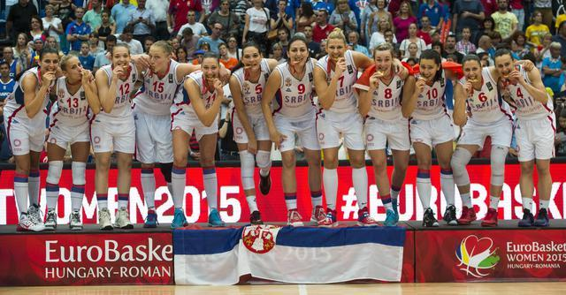
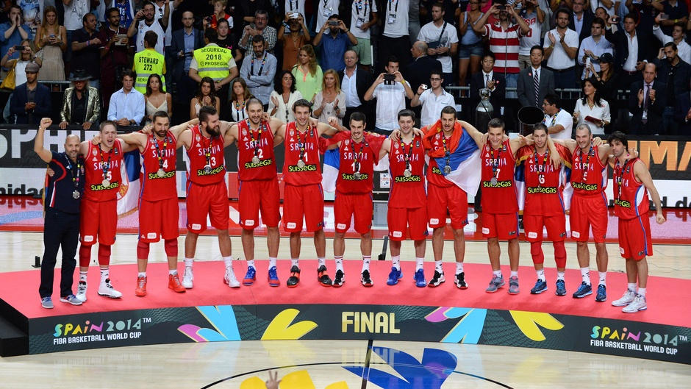
BASKETBALL IN SERBIA
Basketball is the second most popular sport in Serbia.
The national team of Serbia won many medals at the European, Olympic Games and world championships.
In Serbia, women basketball is also popular and our national team won many medals in various tournaments.

