Slide 1
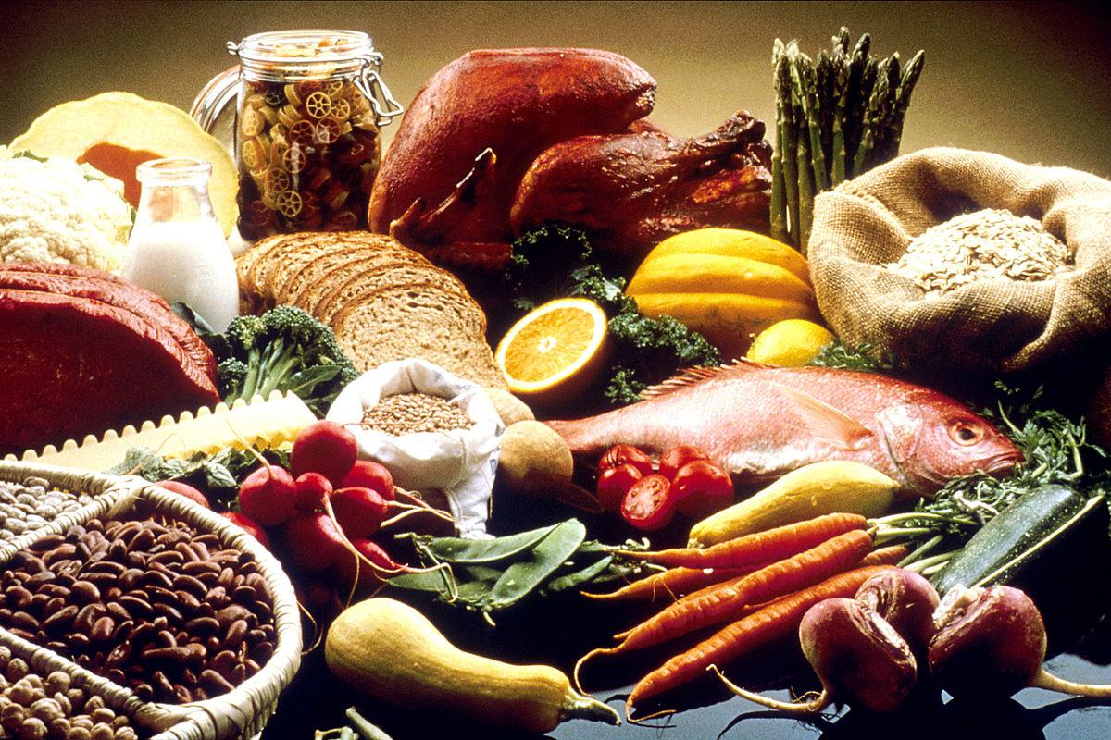
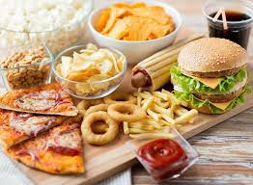
FOOD
(healthy and fast food)
Subject: English Teacher: Milena Tasic Authors: Andrijana Ognjanovic, Jelena Zaric, Marina Gobeljic,
Nevena Bezbradica, Teodora S Lukic II-3

Slide 2
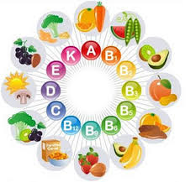
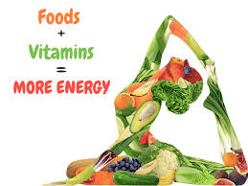
➢ Food is any substance consumed to provide nutritional support for an organism.
➢ It is usually of plant or animal origin, and contains essential nutrients, such as carbohydrates, fats, proteins, vitamins, or minerals.
➢ The substance is ingested by an organism and assimilated by the organism's cells to provide energy, maintain life, or stimulate growth.

Slide 3
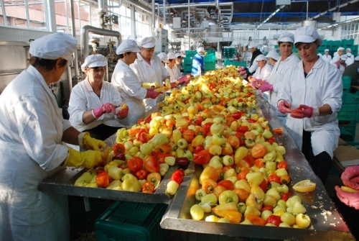
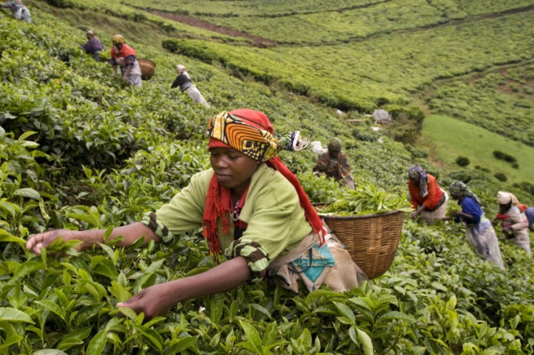
➱Historically, humans secured food through two methods: hunting and gathering and agriculture. Today, the majority of the food energy required by the ever increasing population of the world is supplied by the food industry.

Slide 4
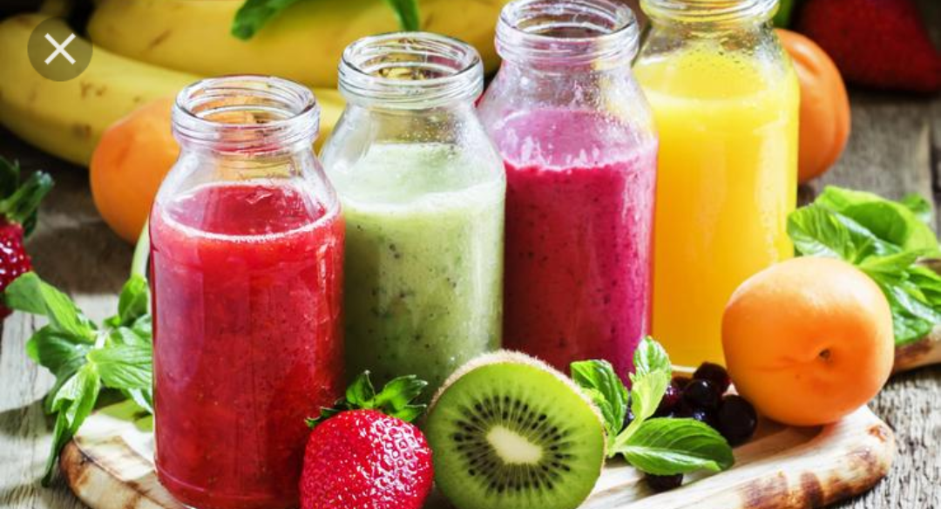
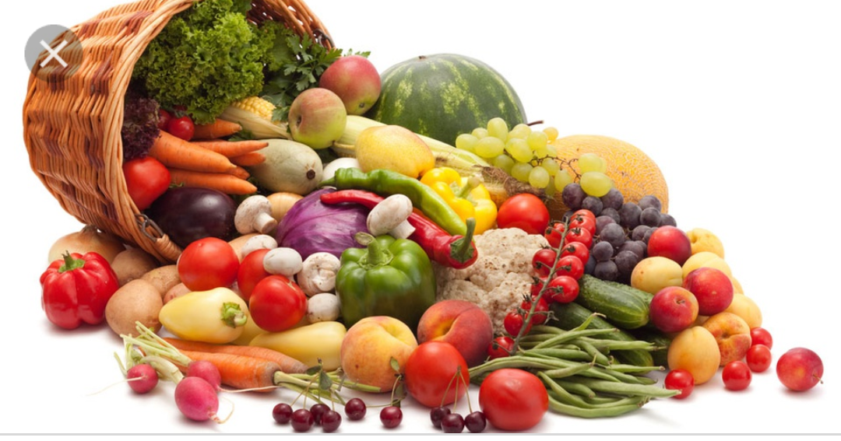
Healthy eating: Emphasizes vegetables, fruits, whole grains, and fat-free or low-fat milk and milk products. Includes lean meat, poultry, fish, cooked dry beans and peas, eggs, and nuts. Is low in saturated fats, trans fats, salt, and added sugars. Balances the calories from foods and beverages with calories burned through physical activity so that you can maintain a healthy weight.

Slide 5
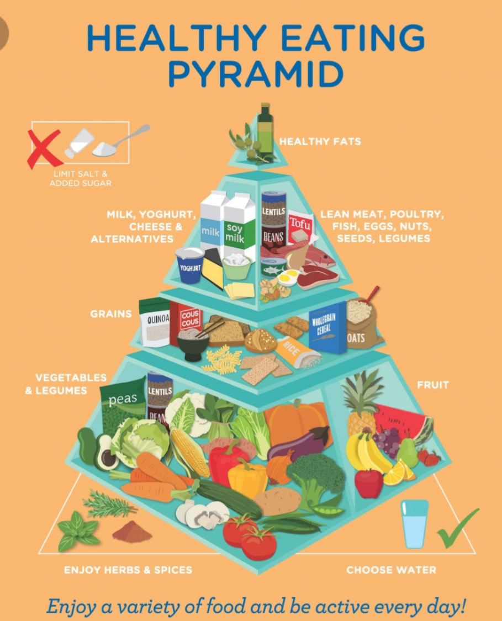
We all know that eating right can help you maintain a healthy weight and avoid certain health problems, but your diet can also have a profound effect on your mood and sense of wellbeing. Studies have linked eating a typical Western diet—filled with processed meats, packaged meals, takeout food, and sugary snacks—with higher rates of depression, stress, bipolar disorder, and anxiety. Eating an unhealthy diet may even play a role in the development of mental health disorders such as ADHD, Alzheimer’s disease, and schizophrenia, or in the increased risk of suicide in young people.

Slide 6
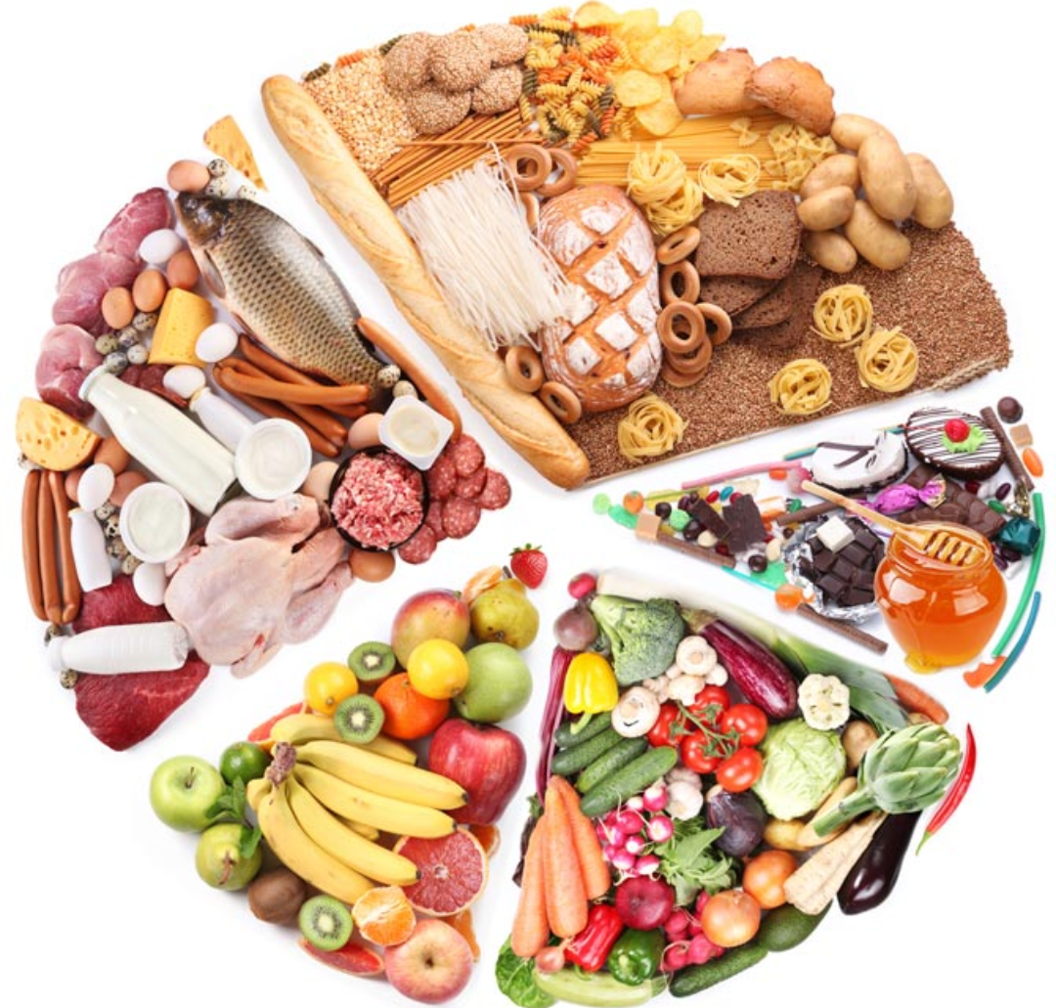
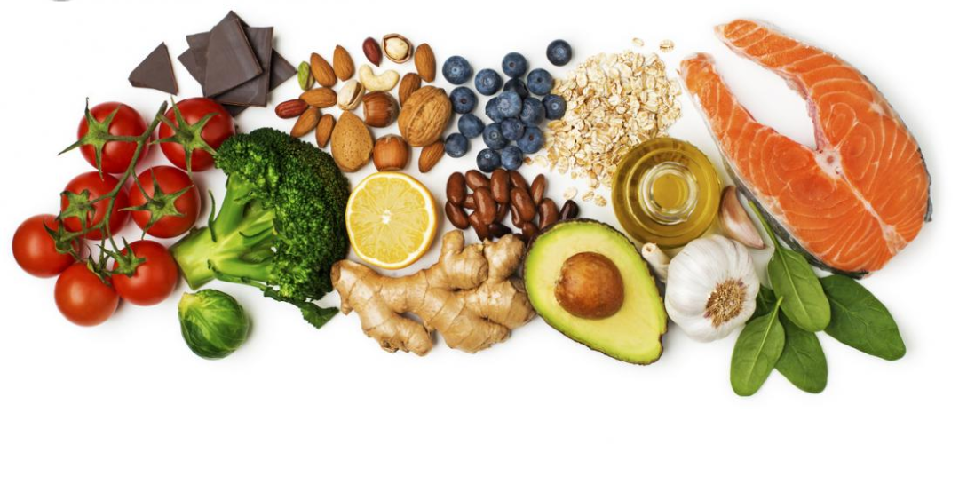
Eating more fresh fruits and vegetables, cooking meals at home, and reducing your intake of sugar and refined carbohydrates, on the other hand, may help to improve mood and lower your risk for mental health issues. If you have already been diagnosed with a mental health problem, eating well can even help to manage your symptoms and regain control of your life.

Slide 7
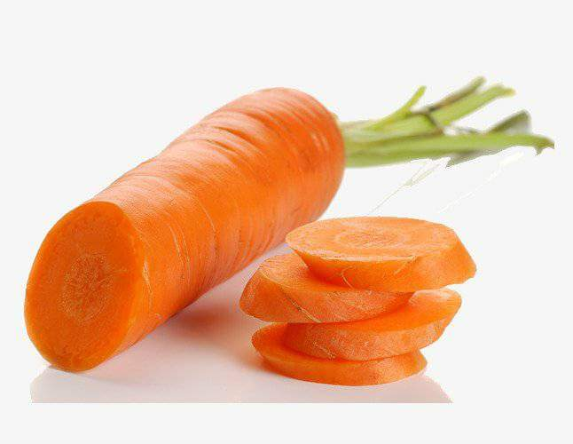
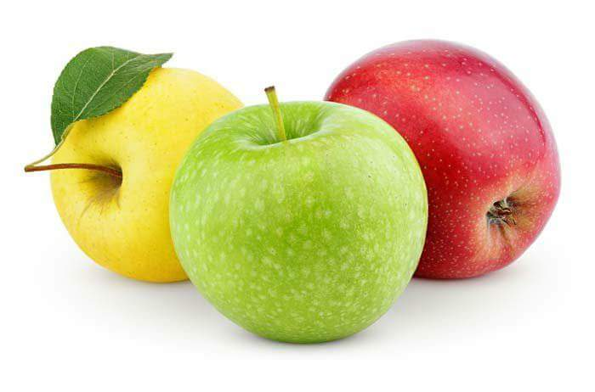
What a healthy diet should contain?
1. Fiber 2. Good fats 3. Micronutrients (vitamins and minerals)

Slide 8
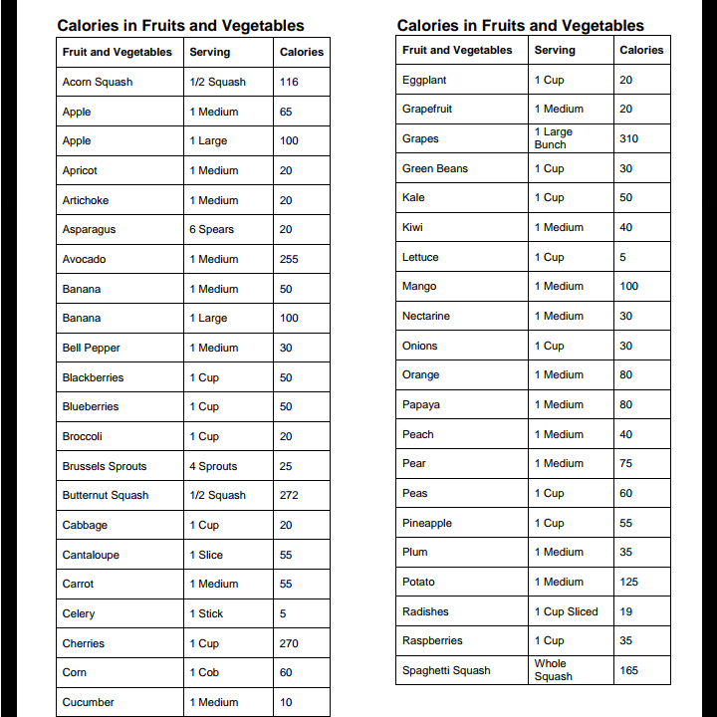

Slide 9
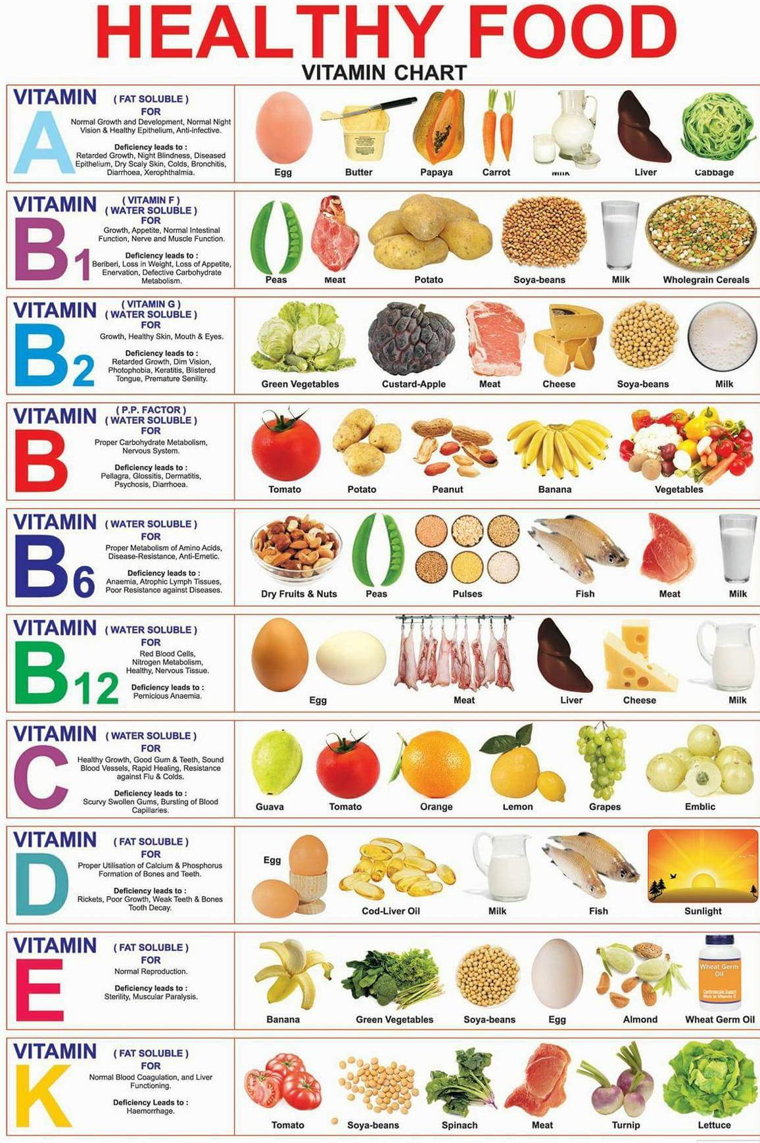
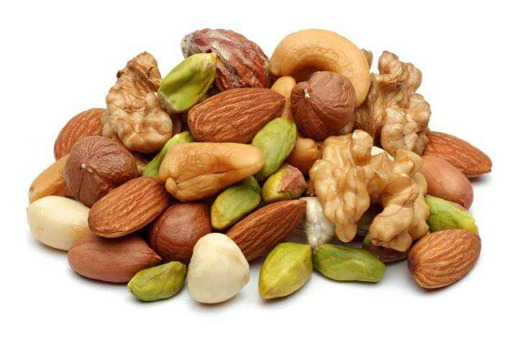
Fruit is a rich source of vitamins, but compared to vegetables, fruits contain less vitamins. Since vitamin fruit contains the most vitamin C and carotene .
Nuts, almonds, hazelnuts, peanuts,seeds, sesame, pumpkin, flax, etc., are very important as a healthy food, rich in minerals, vitamins, proteins, carbohydrates and fats

Slide 10
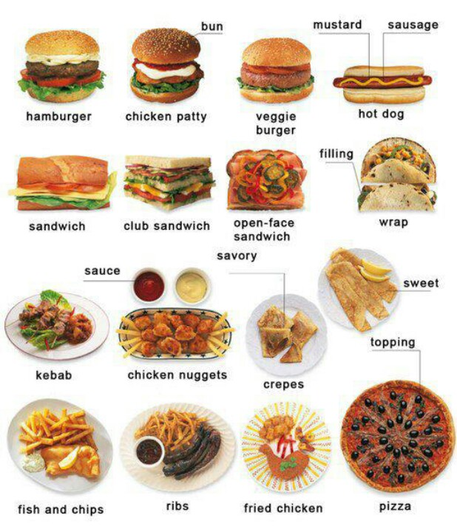
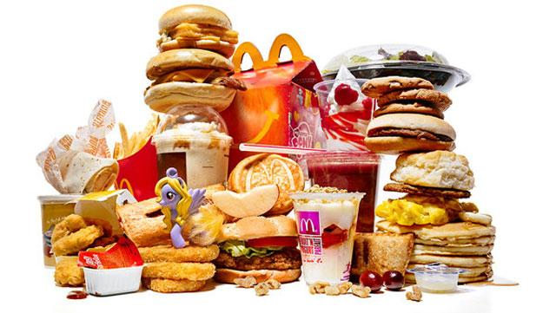
Fast food
Fast food is mass-produced food that is typically prepared and served quicker than the traditional foods.
In the USA fast food is incredibly popular, mostly among children and teenagers.
Things like hamburgers,hot dogs,fried chicken and pizzas fall under the category of fast food.

Slide 11
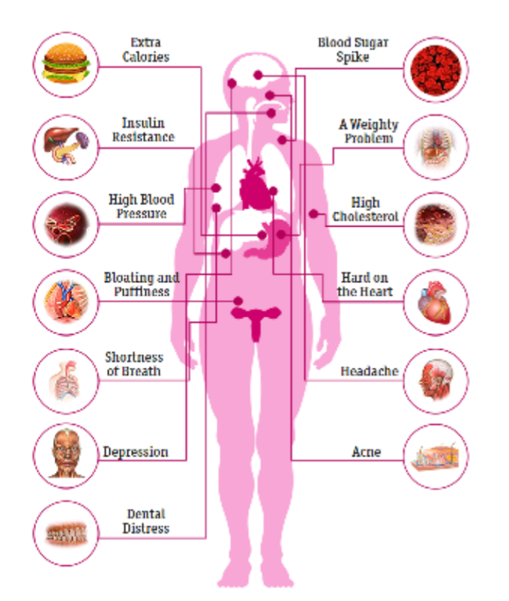
Why fast food isn’t healthy?
Three meals of fast food a week will leave very bad tracks on your immunity beacause it will be conected to asthma, eczema, rhinitis among children and teenagers.
To understand more easily the seriousness of the choices of “wrong” groceries, a graphic of certain issues was drawn.

Slide 12
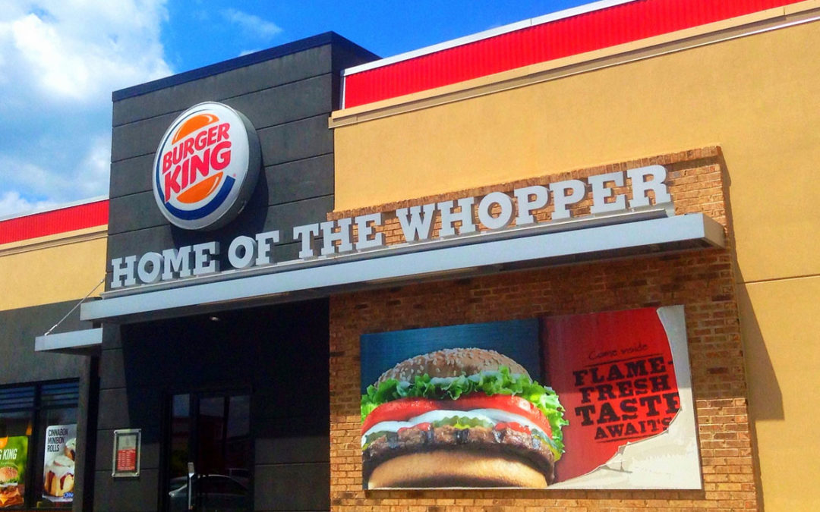
The world's largest fast food restaurants
And while today you can come across a variation of fast food around every corner,the world’s largest fast food chain continues spreading it self across the world are:
Subway
McDonald’s
KFC
Starbucks
Burger King
Taco Bell
Pizza Hut
Domino’s pizza
Arbys
Wendy’s

Slide 13
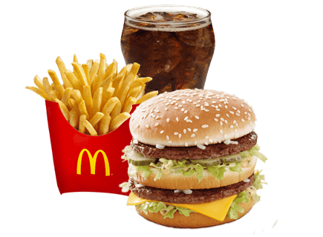
Calories in a fast food
McDonald’s medium fries(337 calories)
McDonald’s 20 chicken nuggets(863 calories)
McDonald’s Cadbury Dairy Milk McFlurry(332 calories)
Large American Hot pizza(2,090 calories)

Slide 14
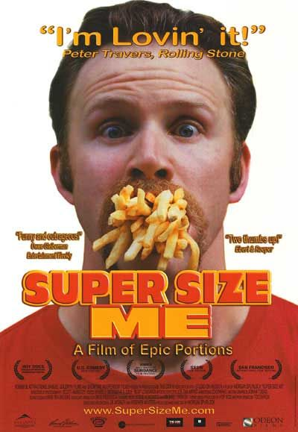
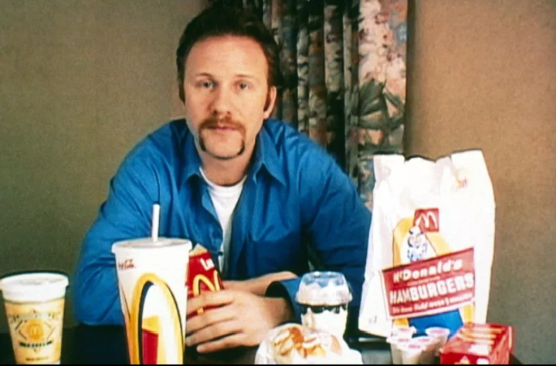
Direct Attack
In 2004 Morgan Spurlock, independent filmmaker, makes a documentary about McDonald’s food
He eats only McDonald’s food for 30 days
At the end of the experiment he gained 11KG

Slide 15
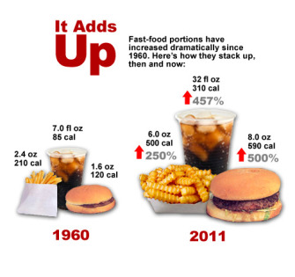
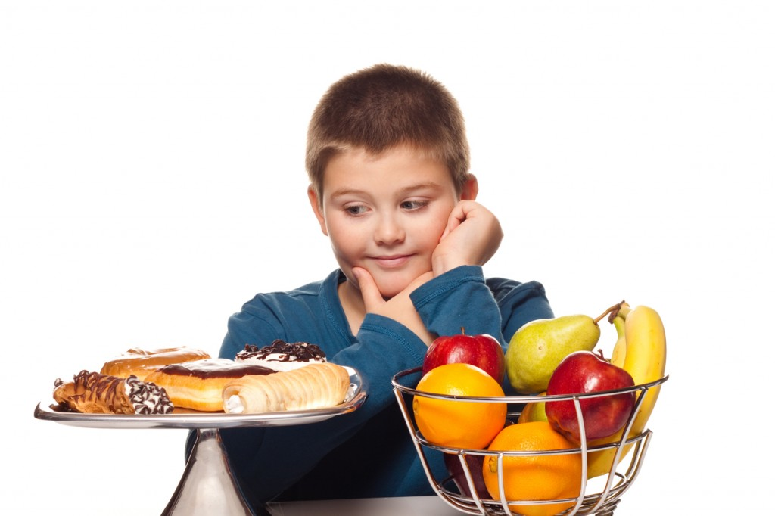
SILENT KILLER(FAST FOOD)

