Slide 1
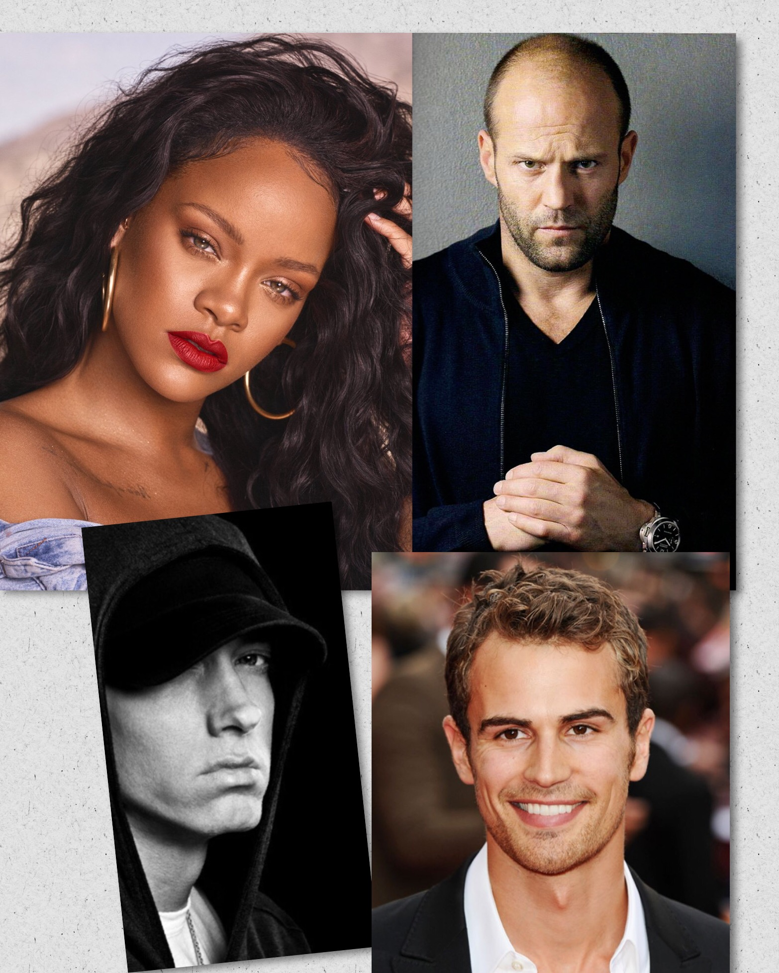
Famous people
Jason Statham, an actor
Rihanna, a pop singer
Eminem, a rapper
Theo James, an actor
Done by:
Maja Mitić,Ivona Stoilović,Nemanja Mišić and Nevena Stoilović II-3
Subject and teacher:
*English, Milena Tasić

Slide 3
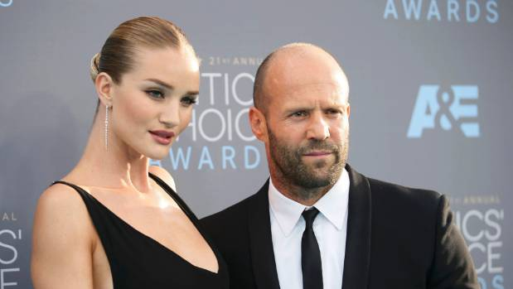
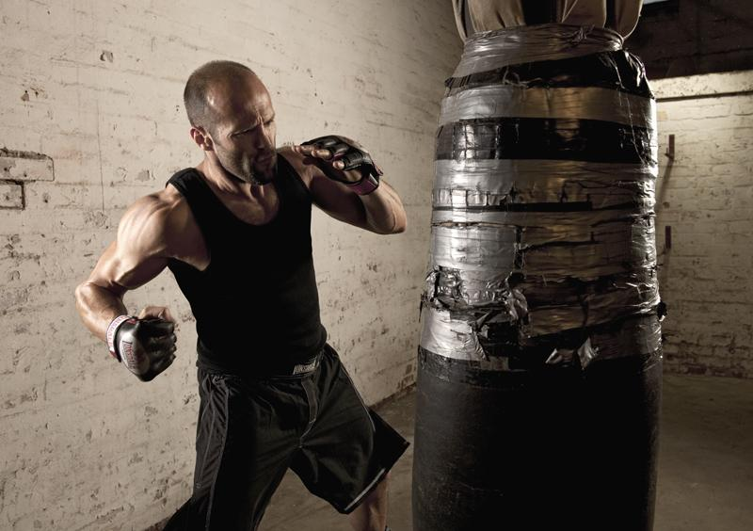
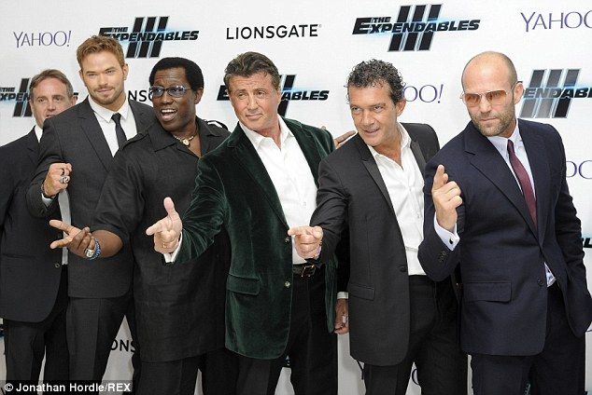
Jason Statham
Jason Statham is an English actor, film producer, and former model. Typecast as the antihero, he is known for his action-thriler roles and portraying tough, irredeemable, and machiavellian characters. Throughout his fil career, Statham has regularly performed his own stage combat and stunts.
About Action film star who gained popularity from his roles in The Transporter film series and Snatch. Other action films he has starred in include War, Death Race, Furious 7, Spy and the Expendables films.
Before Fame
He was close childhood friends with famous football player and actor Vinnie Jones. He trained to become a professional diver and finished in 12th place at the 1992 World Championships.
Family Life
He dated Kelly Brook from 1997 to 2004. He began dating Victoria's Secret model Rosie Huntington-Whiteley in April 2010 and they got engaged in 2016. He and Rosie welcomed a son named Jack in 2017.
Associated With
He starred in the popular action film The Expendables and its sequel with fellow action star Syilvester Stallone.

Slide 4
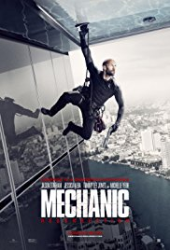
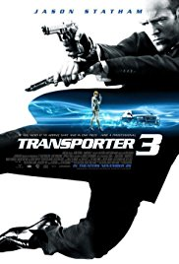
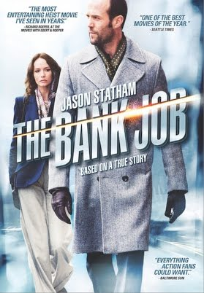
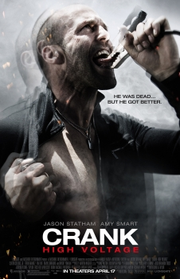
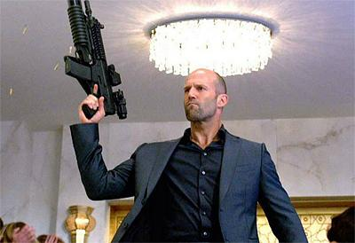
Jason in movies
Statham was offered more film roles, and in 2002 he was cast as the lead role of driver Frank Martin in the action movie The Transporter, in which he was responsible for his own stunts (Statham has made this choice for all of his films). He has studied Wing Chun kung fu, karate, and kickboxing. The film spawned two sequels, Transporter 2 (2005) and Transporter 3 (2008). He also played supporting roles in Mean machine (2002), The Italian Job (2003), and Cellular (2004) in which he played the lead villain.
In 2005, Statham was once again cast by Ritchie to star in his new project, Revolver, which was a critical and box office failure. He played a dramatic role in the independent film London in 2006. That same year he played the lead role in the action film Crank. Statham was asked to promote Crank during the 2006 San Diego Comic con convention.

Slide 7
►Eminem◄
►Marshall Bruce Mathers III-Was born on October 17,1972,known professionally as Eminem.He is an American rapper, songwriter, record producer and actor.Today he is one of the most famous rappers and singers,his story starts here…
►Like i sad,he was born on october 17,1972,A poor single mother raised him as his only son, since the father left the family before Eminem's second birthday and he never contacted. To his 12 years, Marshall and his mother have changed several cities in the state of Missouri before they settled in the suburbs of Detroit.With 14 years of Eminem began to rap with high school friends Mike Ruby and with his cooperation so the name Eminem, later changed its name to Soul Intent and around 1995 they released their first single - F****n Backstabber .Eminem is the first time made a criminal offense as a 20-year-old when he was arrested for participating in a shootout with a gun for paintball.Eminem was not delinquent buthe spent a lot of time with his high school friends and he got into all kinds of troubles.

Slide 8
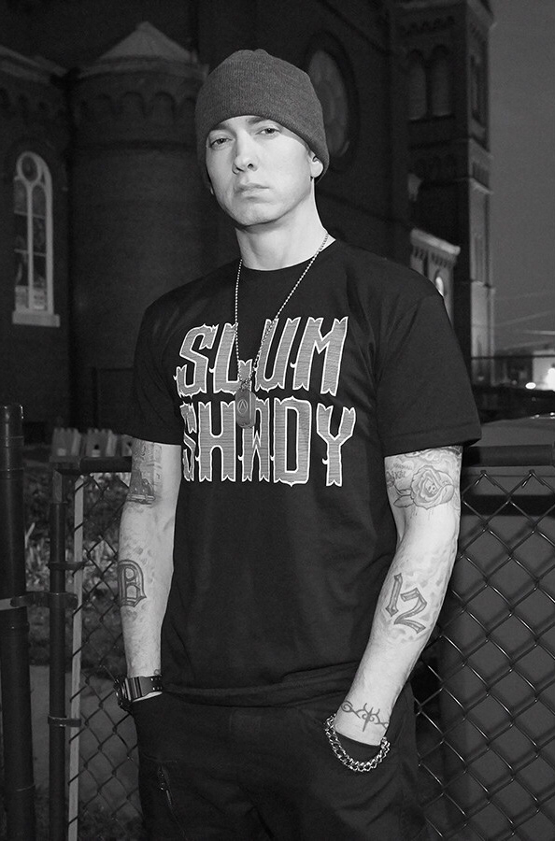
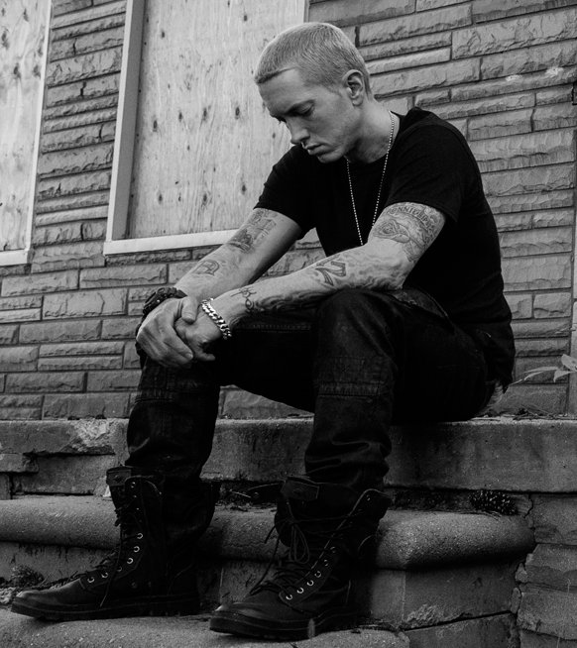
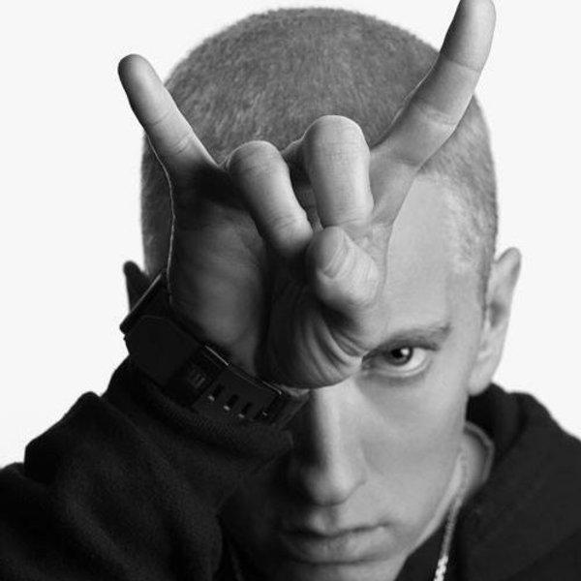
►Acting in movies◄
►After a few minor roles in the film Wash (2001) and by the music video for Got the Life, Eminem made his Hollywood debut in the movie 8 Mile (2002). According to the rapper, it's a representation of growing up in Detroit and not a tribute to his life.On this film was taken in one of his most popular songs Lose Yourself, for which he won an Academy Award for best song written.

Slide 9
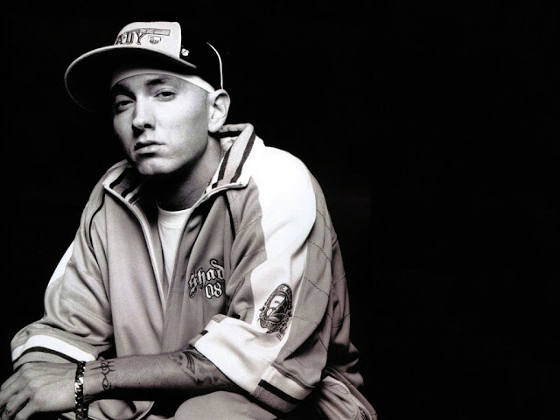
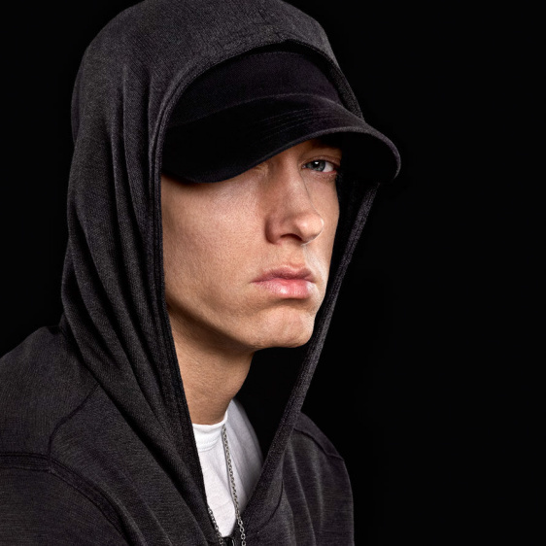
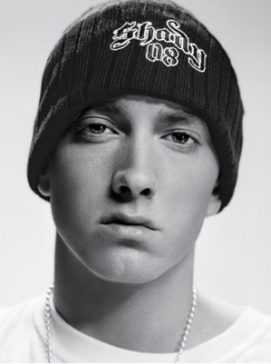
►Top songs◄
➣Lose Yourself
➣When I'm gone
➣Till i Collapse
➣Not Afraid
➣The real slim shady
➣Rap God
➣My name is
And more and more rap songs by Eminem,Now in a break from rapping but we hope to continue his artistic career.♛

Slide 10
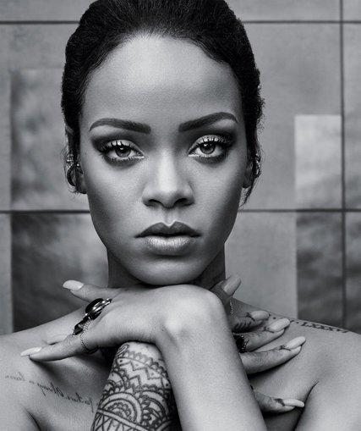
Rihanna
Robyn Rihanna Fenty was born in Saint Michael, Barbados and raised in Bridgetown. She is a singer, songwriter and actress. She became famous in 2005 with the release of her studio album Music of the Sun.

Slide 11
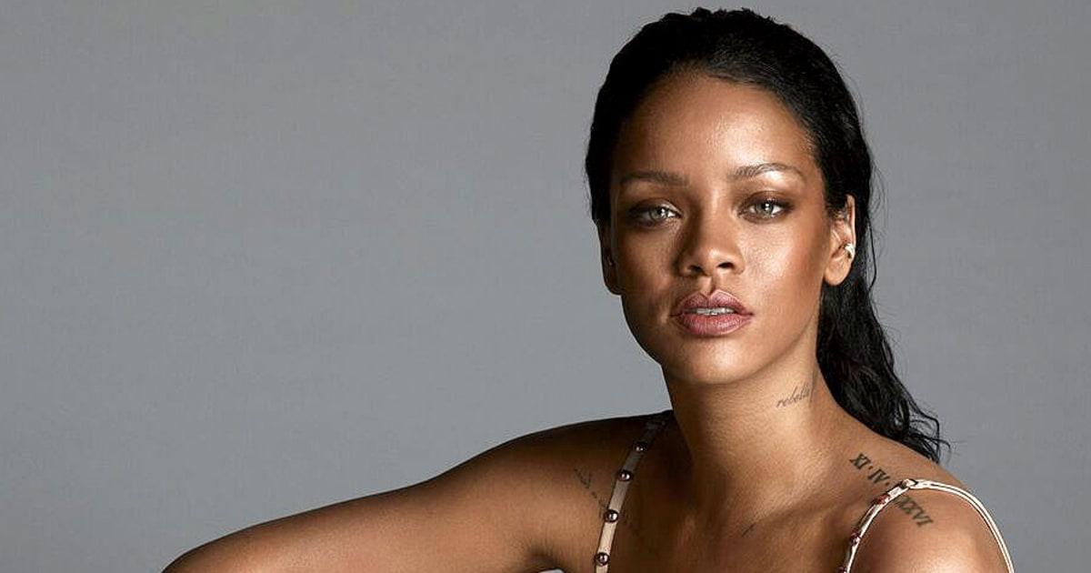
rihanna.com
Rihanna is the youngest solo artist to earn fourteen number-one singles on the Billboard Hot 100. She has a total of thirty one top-ten singles. She was named the Digital Songs Artist of the 2000s.
Rihanna has won nine Grammy Awards, twelve American Music Awards and twelve Billboard Music Awards.

Slide 12
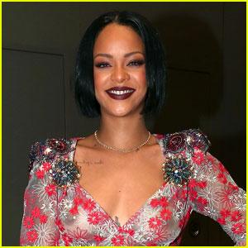
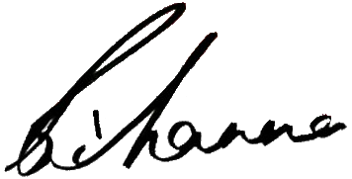
Studio Albums
Music of the Sun (2005)
A Girl Like Me (2006)
Good Girl Gone Bad (2007)
Good Girl Gone Bad: Reloaded (2008)
Rated R (2009)
Loud (2010)
Talk That Talk (2011)
Unapologetic (2012)
Anti (2016)

