Slide 7
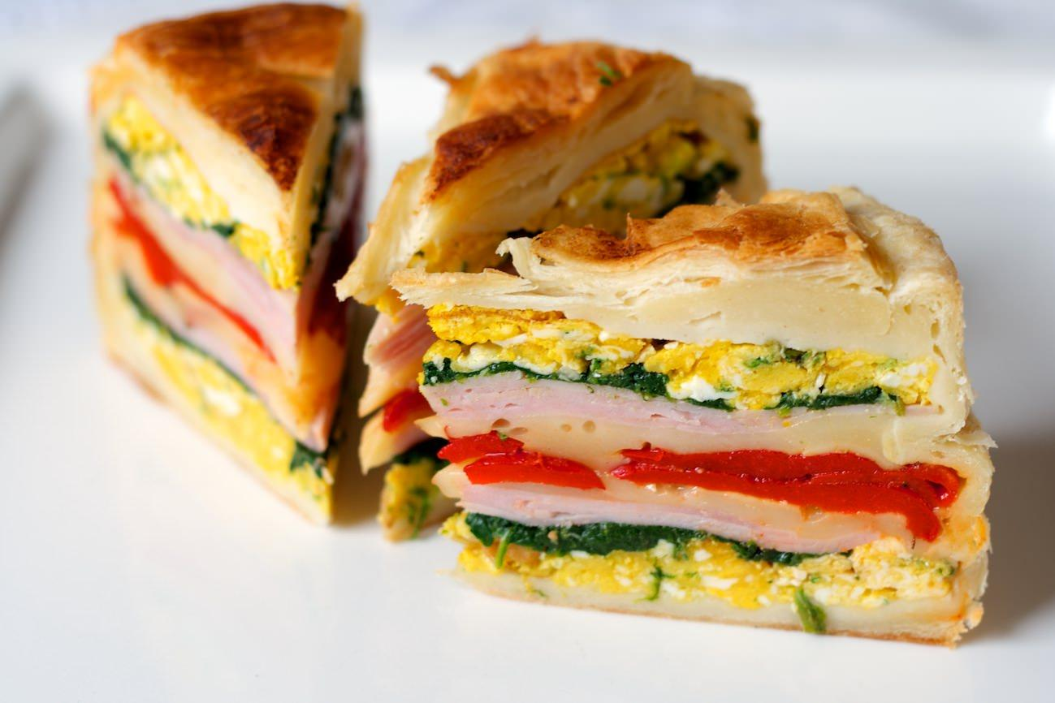
Main course
Saving food is an integral part of the tradition and culture of a nation.

Slide 8
Nutrition is a very complex process and creates what is called “national cuisine” which consists of: the selection of foods, their cultivation,preparation of meals and the why it is served.
It is common to eat three times a day (breakfast, lunch and dinner)-with the remark that the cheapest and most frequent meal-lunch.

Slide 9
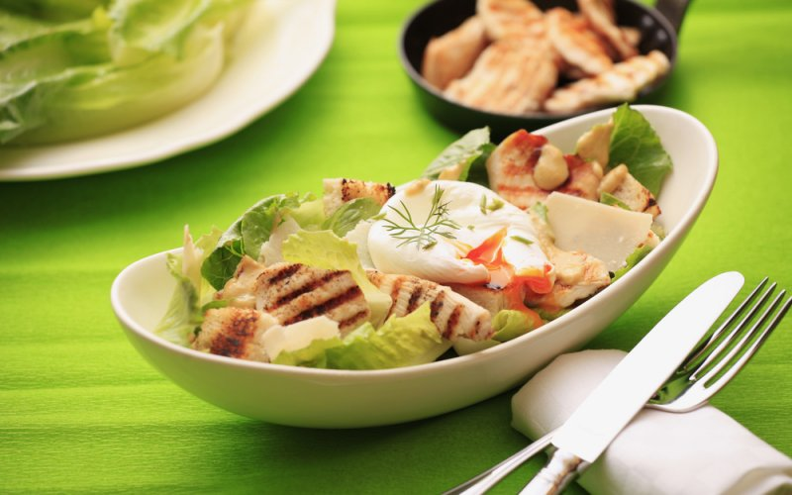
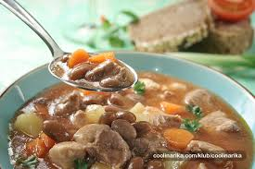
The food are mostly of plant and animal origin.The most important bread is made of wheat, barley, oats…
As the main course,the most common is meat in combination with some vegetables or sauces.

