Slide 1
Amazing Earth
Notes:
Amazing Earth

Slide 10
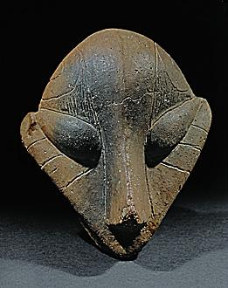
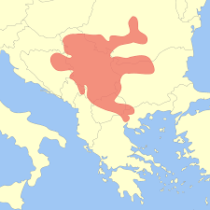
Fallen Civilizations
Many civilizations did not stand up to test of time,so I am going to talk about some of the most mysterious and unique of all.
Vincan culture is the oldest Neolithic culture in South-eastern Europe dated to 5500 years BC. Its influence is found mainly on territory of Serbia. Its people were first metallurgists in Europe. Archaeologists found many sophisticated metal workshops that were possibly most advanced in the world.
First written words were found in south-western Bulgaria that was at that time populated by Vincans.The meaning of these symbols are still unknown but archaeologists are working on deciphering them.
This once great civilization vanished from face of Earth around
Year 4500 BC.Possibly they were integrated into Starcevo culture.

Slide 11
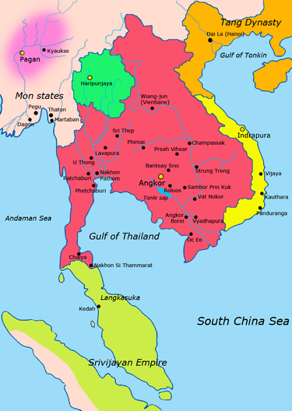
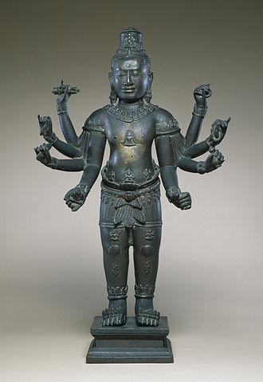
Khmer Empire
Was powerful Hindu-Buddhist empire that occupied territory of Indochina.Angkor Vat is the monumental city built by this mighty civilization, its walls and tower that are still standing strong as ever are rising above 10 meters.
Khmer Empire was military power house,its only worthy rival at a time was powerful Chinese Tang Dynasty.
Khmer Emperors were also patrons of arts and religion.The beginning of the era of the Khmer Empire is conventionally dated to 802 AD. In this year, King Jayavarman II had himself declared chakravartin ("King of the world", or "King of kings")
Its demise in 14th Century AD. were its eternal conflicts among princes of Khmer.Now when we depart to Cambodia we can see a magnificence of its architecture and art .

Slide 12
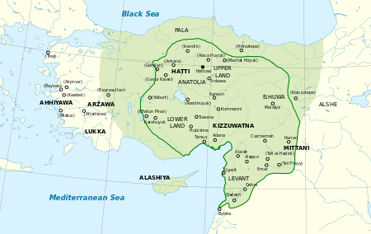
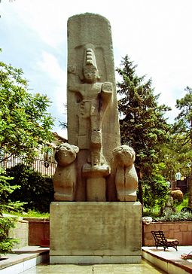
Hittites
The Hittites were an Ancient Anatolian people who found an empire centered on Hattusa around 1600 BC.
Between the 15th and 13th centuries BC the Hittite Empire came into conflict with the Assyrian Empire and Egyptian Kingdom.
The Rosetta stone famous for helping Champollion deciphering Egyptian hieroglyphs was a peace treaty between Hittites and Egyptians.
Hittites glory was demolished by so called Sea people that were marauding east mediterranean coast by the end of bronze age.

